Slide 1
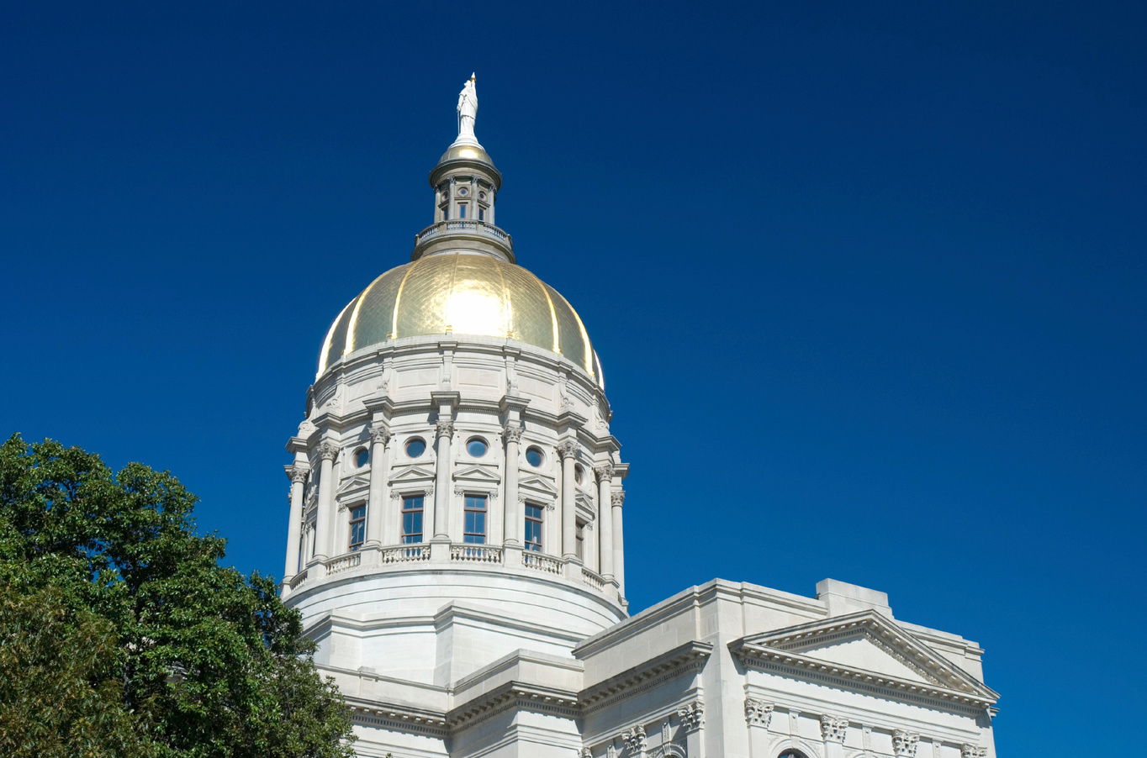

8 Essential Health Care Questions for Georgia Candidates in 2024

Slide 2
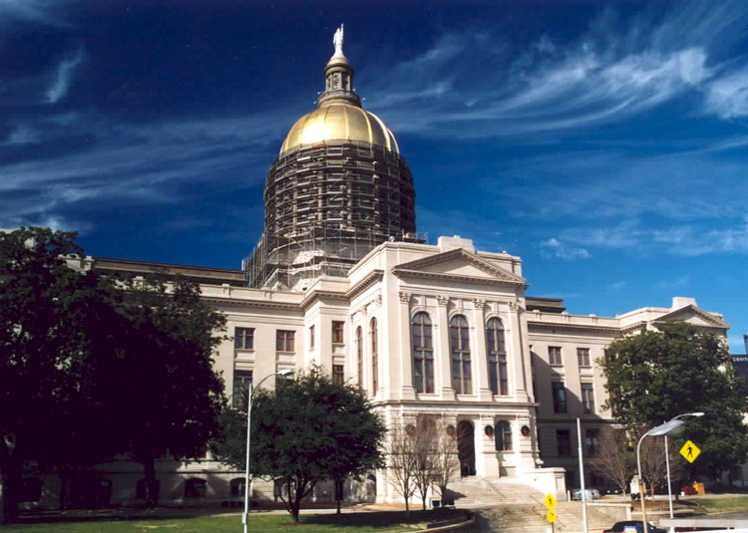

Engaging Georgia’s candidates on health care
As Georgians prepare to cast their votes in this year’s elections, the importance of health care policy is clear. From the future of affordable coverage to the persistent gaps in access for communities around Georgia, the stakes are high. Georgia’s on-going health challenges highlight the need for candidates who prioritize health and wellness. Georgians need elected leaders who will make decisions that ensure access to affordable, high-quality health coverage and care, and support from prepared and resourced public health workers and agencies. These priorities are especially important for communities who have historically had less access.
We’ve developed 8 questions for voters to ask federal, state, & local candidates on key health issues affecting Georgians just like us. These questions can help guide your conversations with candidates at town halls, forums, or on social media.

Slide 3

1. Public Health for All Y’all
“Despite the important role that public health plays in supporting the health of communities and responding to natural disasters and health threats, Georgia has consistently ranked among the bottom 10 states for overall health and well-being, leading to severe health and economic consequences for Georgians. If elected, what specific actions will you take to increase funding for Georgia's public health infrastructure, grow the public health workforce, and build trust between your constituents and public health workers?
Want to know more about Georgia’s public health system and needed attention from elected officials?
Check out our blog here about what public health workers have to say about Georgia’s public health system and share it with the candidates asking for your votes.

Slide 4

2. Medicaid Expansion & Closing Georgia’s Coverage Gap
“Over 240,000 Georgians fall into the Medicaid coverage gap, which leaves them uninsured and without access to health care. Many Georgians in the gap work in essential jobs like child care, health care support, and food services. If Georgia expanded its Medicaid eligibility requirements to cover adults with incomes just above the poverty line, these Georgians would have health insurance and could go to the doctor when they need to without worrying about unaffordable medical bills. In exchange, the federal government would pay for 90% of the program costs and Georgia would receive an estimated $1 billion “sign-on bonus” during the first two years of the program. Do you support expanding Georgia’s Medicaid program to close this coverage gap? Please explain your stance and any alternative solutions you propose.”
Want to know more about Georgia's coverage gap, uninsured Georgians, and the solutions our elected officials can take?
Check out our fact sheet here and share it with the candidates asking for your vote.

Slide 5
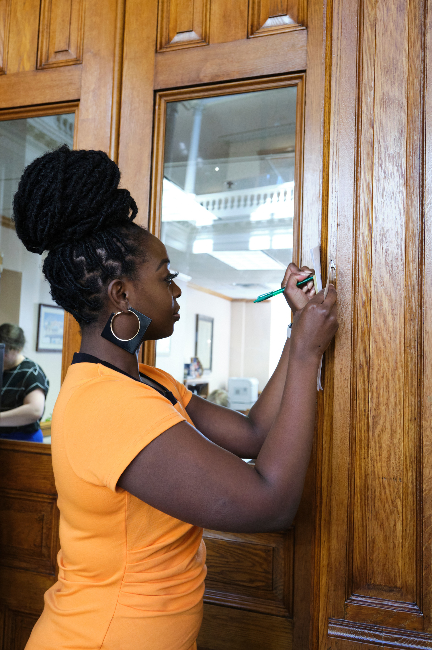
3. Georgia Pathways to Coverage
“In 2023 Georgia launched a limited Medicaid program called Georgia Pathways to Coverage. With only 4,300 enrollees after its first year, the program has struggled to meet its initial goal of enrolling 30,000 Georgians. Pathways has very restrictive eligibility requirements and the application process is complex. Additionally, this program costs almost three times more per-person than traditional Medicaid expansion. Do you support the continuation of this program? If elected, what would you do to ensure your constituents–especially those with low-incomes and few resources–get access to quality, affordable health care?”
Want to know more about Georgia Pathways to Coverage and needed attention from elected officials?
Check out our fact sheet here and share it with the candidates asking for your vote.

Slide 6
4. Costs of health insurance
“In 2021, Congress and President Biden passed the American Rescue Plan (ARP), which lowered premiums by giving Georgians and others more generous financial help when buying health insurance. Since the passage of these enhanced subsidies, enrollment in health insurance has surged, doubling in Georgia. These enhanced subsidies help Georgians afford health insurance; however, they are set to expire in 2025. If the enhanced subsidies expire, 1.2 million Georgians would pay more for their health insurance through Georgia’s state-based marketplace. Do you support the renewal of the enhanced subsidies to lower costs for consumers’ health insurance?”
Want to know more about Health Insurance Access and needed attention from elected officials?
Check out our policy memo here and share it with the candidates asking for your vote.

Slide 7

5. Health Care for Mental Health and Substance Use Recovery
Despite recent legislation and investments by state leaders, Georgia still ranks 49th in the U.S. for access to mental health care. The Georgia Mental Health Parity Act introduced incredibly important changes and protections for insured Georgians, like requiring private & public health insurers to cover for mental health & addiction care similarly to other health issues. Unfortunately, the law doesn’t help uninsured Georgians, who still struggle to access this vital care.
Even with better insurance coverage of mental health & addiction issues, Georgians struggle to find a health care provider affordably or when they need them.
If elected, what would you do to ensure our state continues to invest in and grow mental health services, so that all Georgians (insured and uninsured) have access to affordable, comprehensive, community-based mental health and substance use recovery services?
Want to know more about the Mental Health Parity Act and need attention from elected officials?
Check out our fact sheet here and share it with with the candidates asking for your vote.

Slide 8
6: Ensuring Health Care for
All Georgians
“Black Georgians & other communities of color experience higher rates of chronic disease and shorter life expectancies, while facing long-standing systemic barriers to quality health care. Rural communities are dealing with the closure of hospitals and physician practices, and are showing similarly poor health outcomes. Given that our health is closely tied to factors like housing, employment, education, and access to healthy foods, what specific policies would you implement to address these drivers of health? What specific policy or policies would you champion to reduce racial and geographic health disparities and ensure equitable health outcomes for all Georgians?”
Want to know more about health outcomes for all Georgians and what state leaders can do about it?
Check out our “What the Health, Georgia?” report here and share it with the candidates asking for your vote.

Slide 9

7. Supporting Georgia’s Rural Health Care System
Since 2010, nine rural hospitals have closed in Georgia, leaving many communities without adequate access to health care. How do you plan to address the health care challenges faced by rural communities and ensure that rural Georgians have access to affordable, high-quality health care? Will your policy agenda include increasing access to health care for low-income and uninsured Georgians as a solution?
Want to know more about Georgia’s rural
hospital closures and needed attention
from elected officials?
Check out this report “Georgia Can’t Wait” mini-documentaries here and learn more about how communities struggle when hospitals are allowed to fail. Share these stories with the candidates asking for your vote.

Slide 10

8. Healthy Children
In a 12-month period, Georgia’s Medicaid agency recently disenrolled more than 500,000 children, even though many of them are still eligible for Medicaid coverage. This will increase Georgia’s already high rate of uninsured kids.
School-based mental health services for children and youth are becoming more common and more effective, but Georgia children often struggle with mental health conditions much longer than necessary before they are identified as having a MH need and receive care for their needs.
In 2021, more than 31,000 K–12 students acknowledged that they were homeless.
Georgia kids are struggling. If elected, what would you do to improve the health and well-being of our children and the caregivers that are loving and supporting them?
Want to know more about kids’ health and well-being?
Check out the Whole Child Primer from our partners, Voices for Georgia’s Children.

Slide 11
Your Health Care, Your Voice
Health care is an essential issue for Georgians. By asking candidates these questions, voters like you will help candidates understand your health priorities and issues, and ensure that future health laws and policies reflect the needs of every community in our state.
Raise these questions at town halls, in candidate forums, or directly on social media, so you can make decisions about which candidates will prioritize your health and Georgia’s well-being.

