Slide 1
Population Health in a Reforming Healthcare System: Overview, Trends & Opportunities
Sue Pechilio Polis
Director, External Relations, Trust for America’s Health
Georgians for a Healthy Future
January 14, 2016

Slide 2

Overview
About Trust for America’s Health;
Overview/background of community prevention/population health improvement;
Trends, innovative approaches/multi-sector collaboration;
Engagement opportunities
Resources

Slide 3
About TFAH
“Protecting the health of every community and working to make disease prevention a national priority”
Evidence-based advocacy
Independence, accountability
Our vision of prevention: inside and outside the clinic; individual services and community-wide; policy and systems change vs. one-by-one
  www.healthyamericans.org

Slide 4
The public gets it: opinion research
“Value” – both health and economic outcomes, top reason to invest in public health/prevention
Inextricable connection between inside and beyond the doctor’s office
Supporting healthy choices and local approaches vs. imposing a nanny state
Partnerships are crucial to success

Slide 5
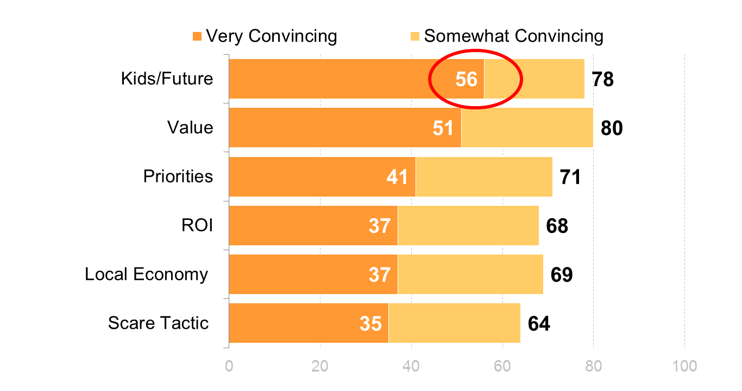
Recent polling on importance of prevention in local communities

Slide 6
The ACA
Insurance coverage
Health system reform
Clinical prevention
A new framework for thinking about what creates health in individuals and in communities…and to achieve the Triple Aim
  National Prevention Council
  National Prevention Strategy
Notes:
ACA has changed the landscape.
Certainly insurance coverage - which I need to say a lot about here given your work/efforts in this area.
Health system reform – and from a pop health perspective a key area has been changes to non-profit hospital community benefit/community health needs assessments – requires collaboration! (Implementation has been the challenge – to not only plan together/but execute together and implement in a holistic way;
Clinical prevention – and with the changes in shift to value-based payment and better addressing super utilizers – this is what has shaken up the landscape perhaps the most.
And initial emphasis in ACA (Prevention Strategy – Prevention Fund)

Slide 7
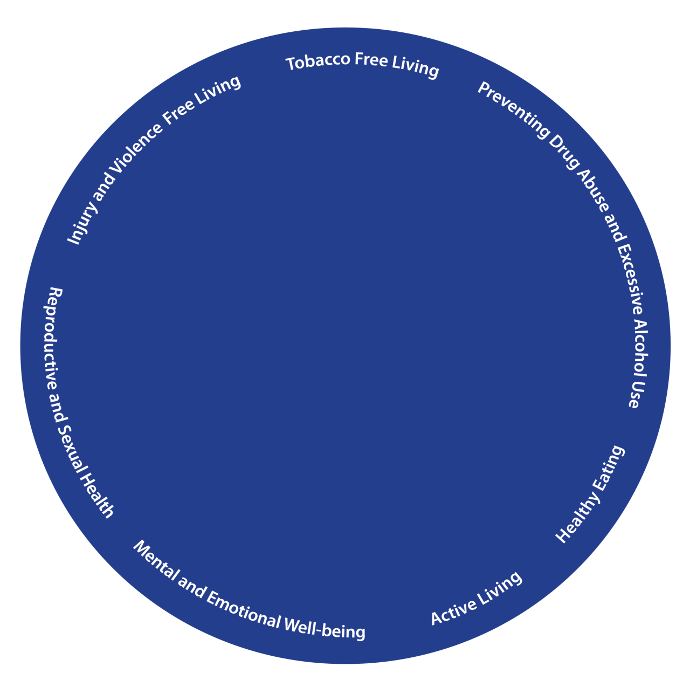
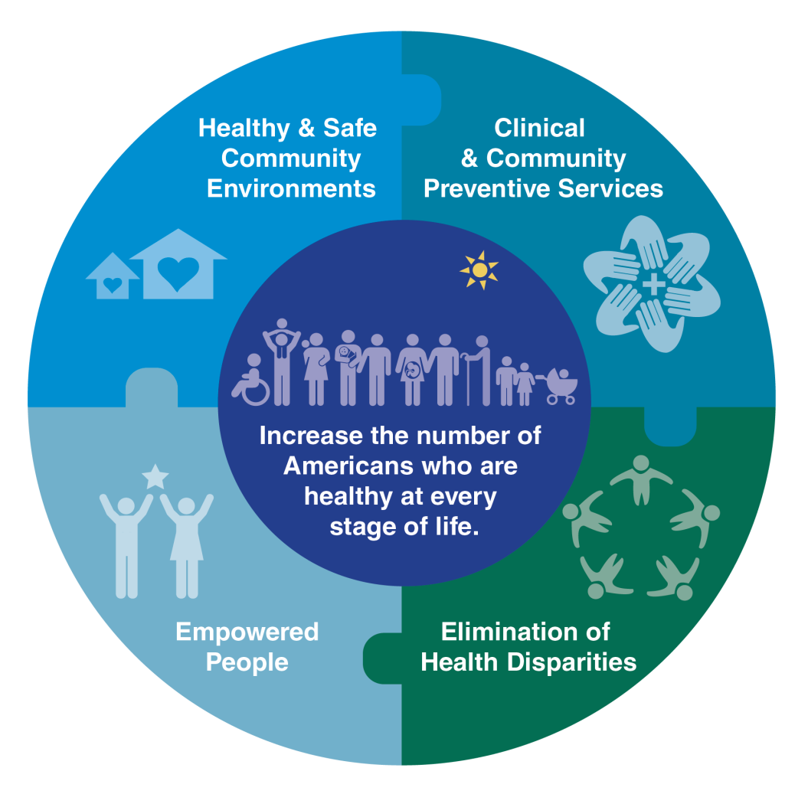

National Prevention Strategy:
Goal ∙ Strategic Directions ∙ Priorities
Notes:
A new era for public health: to achieve the goals of the NPS requires a partnership across all sectors.
The National Prevention Council provides ongoing coordination and leadership at the Federal level on how agencies can work together to improve the nation’s health
Helps each agency incorporate health considerations in decision-making
Enhances collaboration in prevention and health promotion initiatives
Four pillars
Healthy and Safe Community Environments
Clinical and Community Preventive Services
Empowered People
Elimination of Health Disparities

Slide 8
Population Health: The New Buzzword
Fundamentally about thinking more comprehensively about what care inside the clinic means and linking it to the conditions outside the clinic
  Public understands this conceptualization better than social determinants of health
Requires partnerships; requires targeted and universal interventions (policy/systems change)
Does not mean we are making everything a responsibility of the health system…but it does mean that all parties need to partner
  Community development, housing, transportation, education
  Shared resources, coordinated/braided approaches
Notes:
-Two years ago – we could barely get any resonance with health plans/hospitals – the tables have shifted significantly – and now many community health plans/Medicaid MCO’s are leading various efforts to see what works…
Molina – really out in front on CHW’s and better establishing connection between patients (vulnerable pops) and connect to social services and other unmet needs.
This is the overarching trend now from Kaiser to Care Oregon – this has been a major strategy.
Hospitals – good example – the Children’s Hospitals – wasn’t really on their radar. Less than a year since we started outreach, a Board approved shift to population health improvement.
----
Partnered with US Chamber Foundation to explore the role of business in community prevention (going beyond workplace wellness) – led to the RWJF $ Better Health Through Economic Opportunity Campaign
Health/ED Collaborative – rooted in addressing chronic absenteeism
Housing/Hunger/Parks & Rec/ - on and on…
Recognizing the demand – we’ve built some tools and resources which I’ll cover at the end..

Slide 9
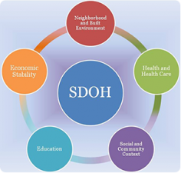
Basic premises from the perspective of a public health advocate
Notes:
Public health has tried to “own” the concept of population health – but it is too important to be left to public health agencies alone, especially if we are serious about addressing disparities.
The very nature of the SDOH calls for collaboration with other sectors – no one organization/sector can do it alone to address root causes

Slide 10
Who leads? It depends….
Notes:
This is an important visual that we feel shows the required collaboration needed/unique roles and how it all fits together.

Slide 11
Today’s Population Health Efforts –
Key Components
Organized to improve the health of a population
Partners with multiple sectors
Redesigning processes and systems to transform care and, in particular, to link clinical care with community prevention and social services.
Demonstrates results, both improved outcomes and evidence of utilization reductions and/or cost savings in the health care system
Invests in prevention, including addressing causal factors in community health through policy and environmental change
Supported by an “integrator” that convenes and coordinates
Notes:
A population health initiative…
That said – we’re seeing a lot of models emerging from earlier CMMI investments e.g. SIM with initial work in AHC.
Early emphasis on funding, data, partnerships….
Most do not yet include policy, systems and enviro change but we are seeing models that have incorporated work of this nature – SW WA HLC
SRTS
Housing Policy

Slide 12
What Does It Look Like in the Real World?
Broad efforts
Condition-specific efforts
Efforts to address the SDOH
Efforts to improve health equity
Notes:
A range of efforts…
-CDC (Heart Disease and Diabetes emphasis) & Partnerships to Improve Community Health
(this has been an evolution – with earlier efforts like CPPW, CTG…) but building support given connection to ACA, misperceptions of efforts etc require a new way forward and that’s something TFAH is proactively working on now.
-CMMI – existing and new investments
-Health plan/hospital led – runs the gamut
-Community Gardens
-Farmers Markets
-Health Zones
TO
-some of the examples I’ll share now

Slide 13

Notes:
Seeing leadership emerging from new places
ProMedica Health System (now Root Causes Coalition with AARP, CDC Foundation) – gaining traction with many state-based hospital associations
-Started with an emphasis within their respective health system community – hunger as a health issue and partnership with food banks, healthy cooking, farmers markets but has evolved into an effort to grow a national coalition to address the underlying social determinants

Slide 14
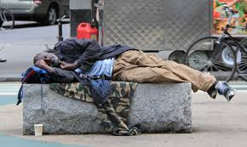
Notes:
ACAP Positively Impacting Social Determinants of Health: How Safety Net Health Plans Lead the Way, June 2014
UPMC for You
Pilot that has been expanded
Partnership with UPMC and Housing Agency among other efforts
United Healthcare

Slide 15

Notes:
Wisconsin Children’s Hospital – School Nurses, connecting students/patients (with emphasis on students with chronic conditions e.g. ASTHMA) to community resources
Nemours – shared data/records between clinics and school nurses
Community level efforts – including policy
Safe Routes to School
Healthy School Foods
Nationally, Health/Ed Collaborative

Slide 16

Notes:
Hospitals as anchor institutions
UH Cleveland, Evergreen Cooperative

Slide 17
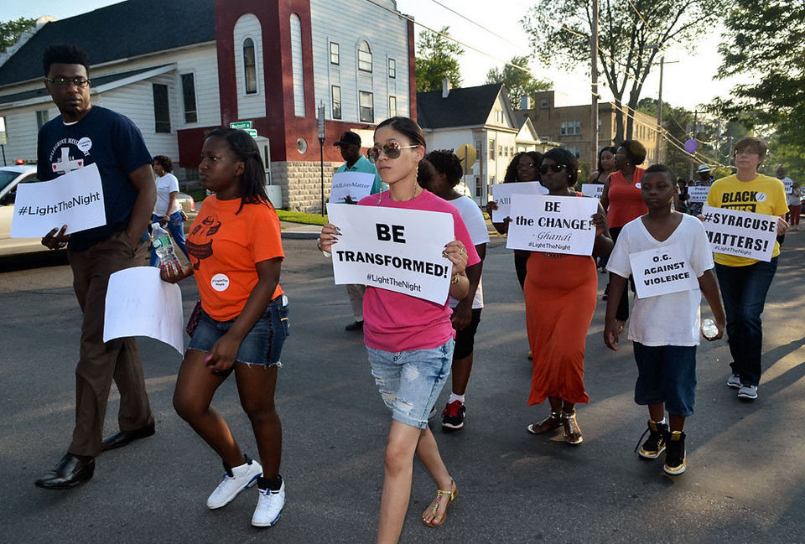
Notes:
Hospitals intervening in the cycle of community violence

Slide 18
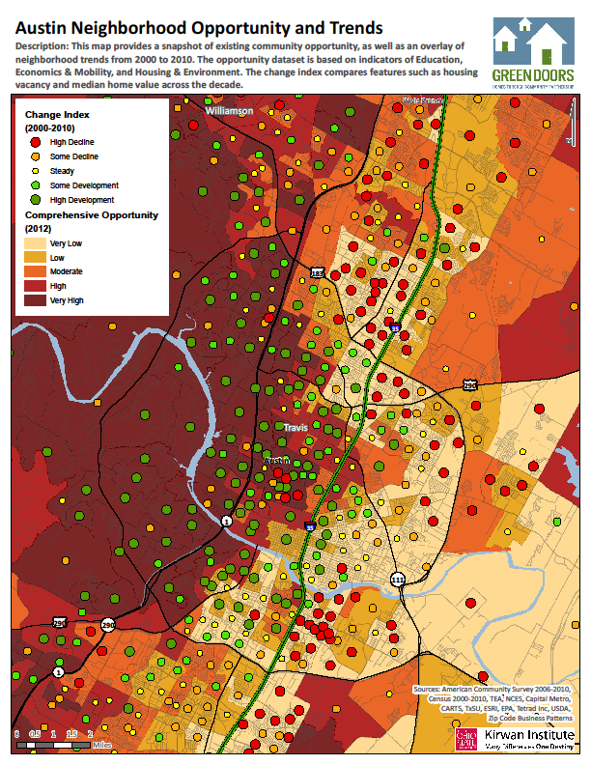
Notes:
For most of us, the neighborhood is our “ecosystem,” a place that can either provide the opportunities we need to grow or stifle our potential. We generally know an opportunity-rich neighborhood when we see one: a place that provides access to quality schools, healthy food and recreational options, stable and supportive housing, sustainable employment, and strong social networks.
This map of Austin show the opportunities as shading, with the lightest shade representing the least opportunity neighborhood. The dots represent home vacancies and median house values, with green as improving and red, declining.
For many marginalized communities, particularly low-income communities and segregated communities of color, neighborhood conditions limit access to opportunity and advancement. Residents concentrated in opportunity-deprived communities lack access to steady employment, essential services, and good schools, and often live in unsafe environments. In these neighborhoods, under-resourced schools struggle to meet the myriad needs of children in poverty; parents shop at grocery stores with overpriced and low-quality food; and people motivated to work lack connection to meaningful, sustainable employment. This geographic isolation from opportunity creates artificial barriers to improvement for these residents and significantly diminishes their quality of life.
http://kirwaninstitute.osu.edu/wp-content/uploads/2013/09/FINAL_OM_9-5.pdf

Slide 19
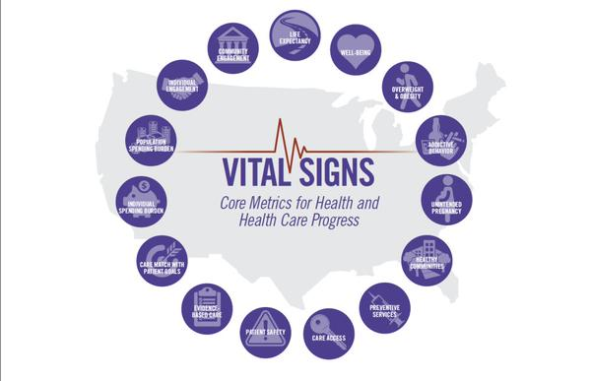


Evolving Efforts
ACO
AHC
Notes:
ACO to ACH Why?
What are you trying to achieve? Quality measures for Medicaid, HEDIS measures, other risk-based contracts:
Reduce BMI
Increase the provision of weight assessment and counseling
Immunize everyone who should be
Screen or lead, cancer, infectious diseases
Manage asthma, diabetes and other chronic diseases
Control high blood pressure
Reduce risk of falls
Increase PA in older adults
Spending on social services less in US as compared to other countries, spending on medical care more, yet Elizabeth Bradley’s work shows that the ratio of social to health spending was significantly
associated with better health outcomes (Less infant mortality, low birth weight, premature death; longer life expectancy)
Not just the responsibility of managed care OR any one sector!
REQUIRES:
PARTNERSHIP
COMMUNITY ENGAGEMENT
FINANCIAL MODELS THAT SUPPORT UPSTREAM INTERVENTIONS – OR CCOs, SIMs, AHCs, Wellness Trust, Preventive Services and Free Care policy changes
DPP example of reimbursed intervention
Braiding of funding streams – managed care has flexibility with how dollars can be spent
The Guide for Community Action (Action Guide) is a handbook for anyone who wants to improve health across a population, whether locally, in a broader region or state, or even nationally. The Guide’s purpose is to support individuals and groups working together to successfully promote and improve population health over time. It contains brief summaries of 10 useful elements that are important to consider when engaging in collaborative population health improvement efforts, and includes examples and links to practical resources.
This Population Health Endorsement project sought population-level measures inclusive of the other two approaches from the NQS’s three-tiered approach to population health, including a focus on healthy lifestyle behaviors and community interventions that improve health and well-being, as well as measures that assess modifiable social, economic, and environmental determinants of health and outcomes of populations.
IOM Pop Health Roundtable and Vital Signs – pop health approach to measurement

Slide 20
Opportunities
Recent CMMI Funding Opportunity Announcement – Accountable Health Communities
  Bridge clinical care and social services
  Emphasizes clinical/community partnerships
  Acknowledges the critical need to address underlying social determinants of health and equity
State Legislative Efforts on Community Health Worker training/certification standards
Health/Education – Free Care Rule
Notes:
http://www.astho.org/public-policy/public-health-law/scope-of-practice/chw-certification-standards/
On December 15, 2014, Cindy Mann, Director of the Centers for Medicare and Medicaid Services (CMS), issued a State Medicaid Director letter that removes a key barrier to funding school health services: the free care policy. The clarification of this policy provides an opportunity to leverage the role that schools can play in increasing access to a system of comprehensive and coordinated health services for Medicaid-enrollees. Since 1997, the free care policy has stated that Medicaid funds may not be used to pay for services that are available without charge to everyone in the community. This rule has presented a barrier to maximizing the role that schools can play in prevention, population health, care coordination and chronic disease management.
Implementation of the free care policy will vary by state. Each state must decide to allow school districts to bill for the health services delivered to students. In many states, this will require an amendment to the state Medicaid plan since most states currently do not allow schools to bill for health services delivered to students without individualized education programs. Since each state’s Medicaid plan is different, the amendments to each state plan will also be different. If you are interested in learning more about what would be required to implement the change in the free care policy in your state, we encourage you to start by familiarizing yourself with your state Medicaid plan to better understand what school health services are currently recognized in your state plan.

Slide 21
TFAH’s Population Health Work
Blueprint for a Healthier America agenda
Twin Pillars work post ACA passage
National Forum on Hospitals, Health Systems and Population Health
Accountable Health Communities
Healthy Communities Navigator
Population Health Webinar Series
Medicaid and Community Prevention Group

Slide 22
Georgia
Georgia Health Policy Center
  Population Health Improvement Efforts (ARCHI)
Partnerships to Improve Community Health
  Fulton County Health Department
  Tanner Medical Center
  AHA, National WIC, APA Sub Grants
See Healthy Communities Navigator for more information and other grant programs

Slide 23
Thank you
Recently Launched: Healthy Communities Navigator: Cross-sector Grants, Success Stories and Policy Papers
  http://healthyamericans.org/healthycommunities
Community Prevention & Multi-Sector Stakeholders Webinar Series:
  1/20 – Accountable Health Communities
  1/27 – Anchor Institutions
  www.healthyamericans.org

