Slide 1
Expanding coverage in Arkansas The Private Option
Marquita Little, Health Policy Director
Arkansas Advocates for Children and Families
January 2015

Slide 2
Introducing AACF
Mission Statement: “To ensure that all children and their families have the resources and opportunities to lead healthy and productive lives and to realize their full potential.”
Major issue areas:
Health
Foster Care
Juvenile Justice
Tax and Budget
Education
Immigration
Notes:
We work to set state policy that is child, family, and consumer-friendly, focusing on low- and moderate-income families.
Some of the things we are known for are ARKids First and pre-k.

Slide 3
Health care landscape in AR before extending Medicaid
Major gains covering children – 6% uninsured
About ¼ of Arkansas adults were uninsured – half a million folks.
Estimated 250,000 below 138% FPL
At least 80,000 low-income PARENTS uninsured
One of leanest Medicaid programs in the country
No coverage to childless, nondisabled adults
Coverage for parents up to just 17% FPL
For lower-income Arkansans, more than half were uninsured in some counties.
Significant Medicaid budget shortfall projected
Notes:
May also know this as “obamacare” – it’s President Obama’s health law that puts into place lots of protections and helps ensure better, affordable coverage for Americans.

Slide 4
ARHealth+ARJobs Coalition
Coalition focused on Medicaid Expansion

Slide 5
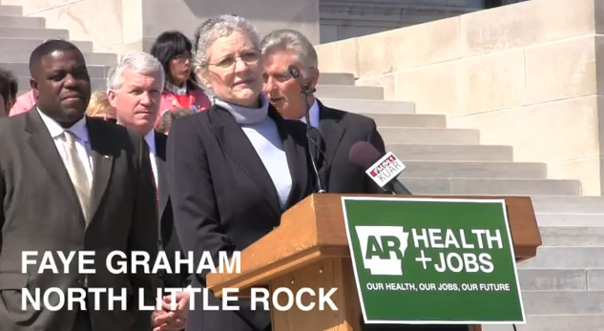
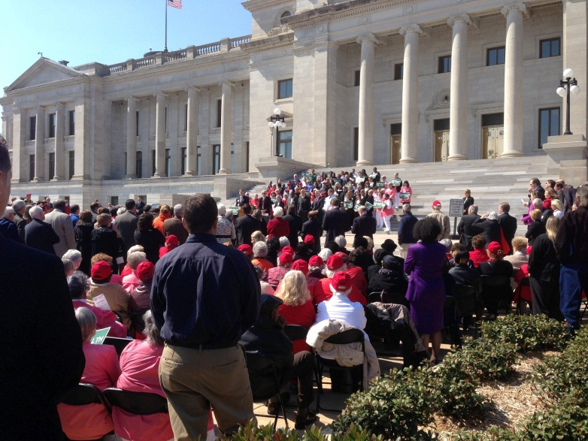
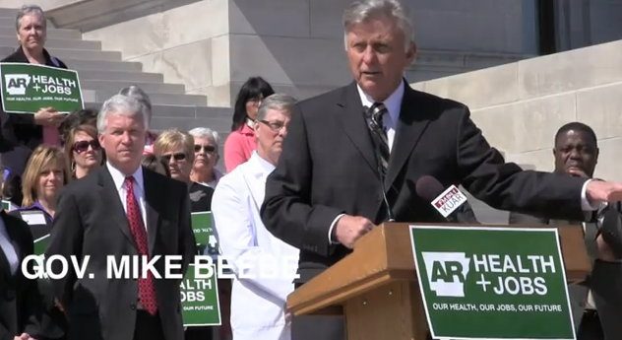
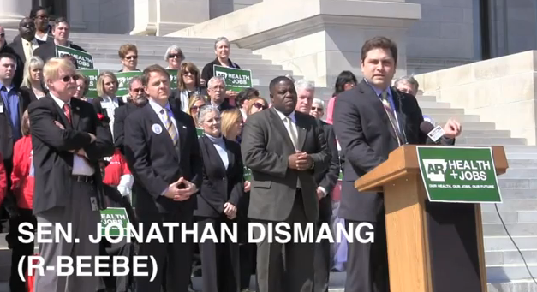
ARHealth+ARJobs Rally

Slide 6
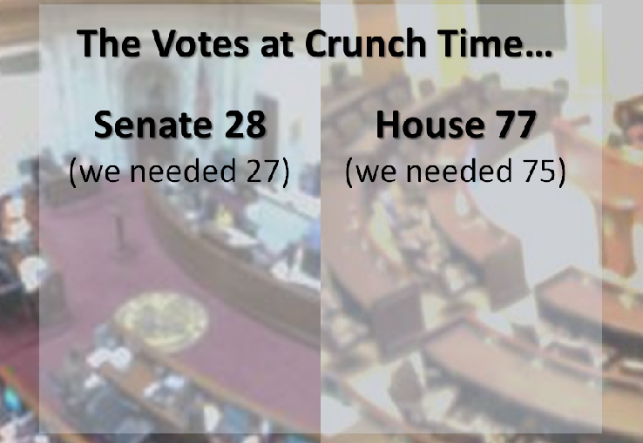
After much debate…

Slide 7
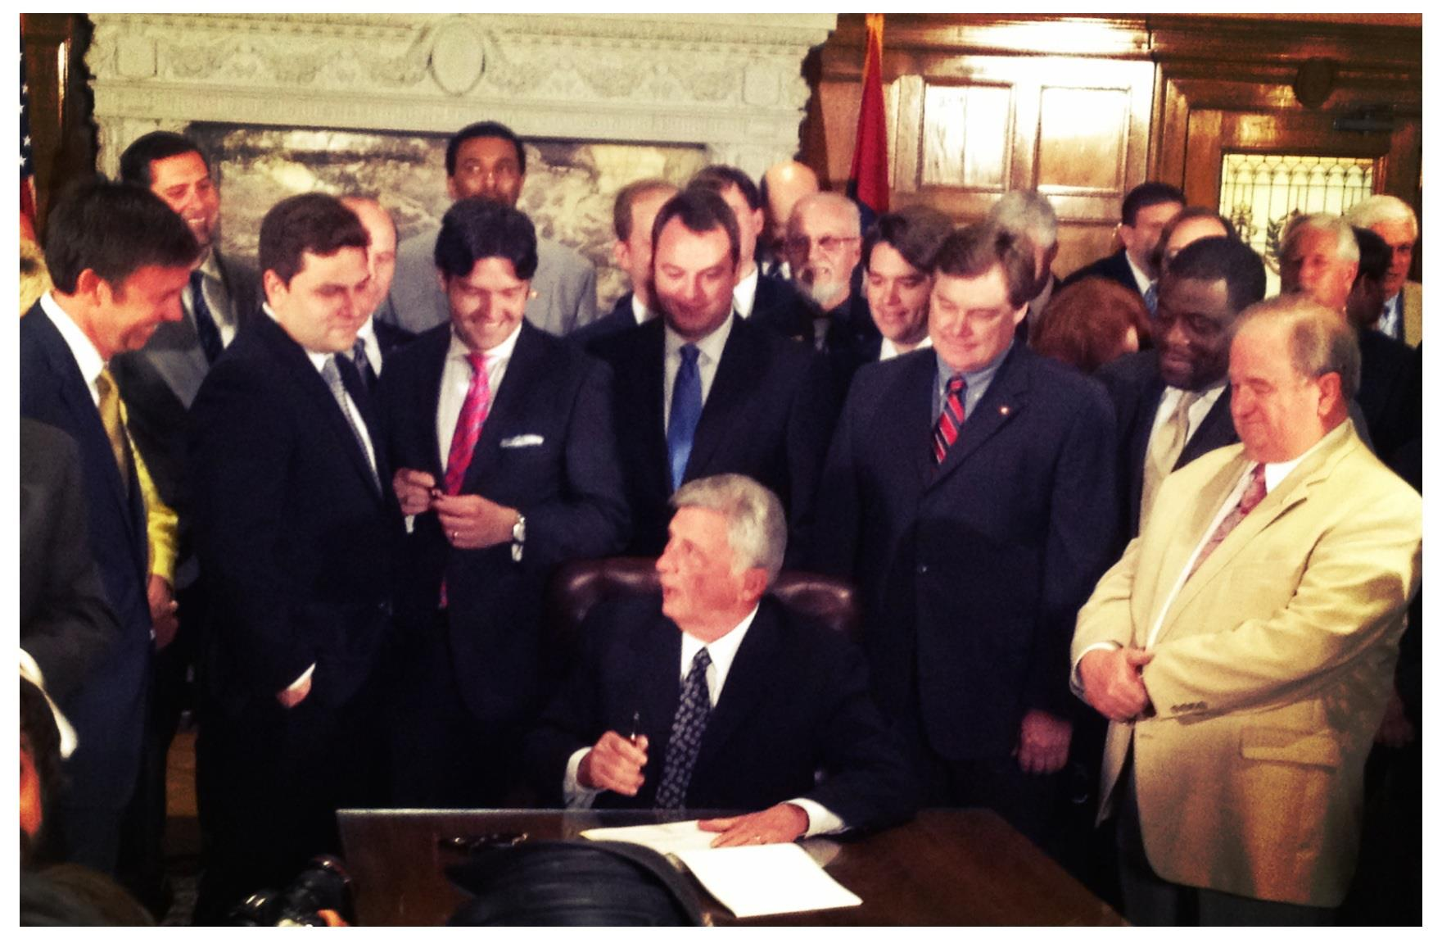
On April 23, 2013….
Gov. Beebe Signed the Health Care Independence Act into law.

Slide 8
Why the Private Option model?
Expanding private coverage and downsizing Medicaid
Theme of promoting personal responsibility
Attracting insurance carriers and enhancing competition in Marketplace
Improving continuity of coverage vs. churning

Slide 9
Private Option: Key Features
Use Medicaid funds to purchase private health insurance through AR’s Insurance Marketplace
19-64 years old, Up to 138% FPL
No premiums for enrollees
100% paid with federal funds until 2016
Medicaid consumer protections
Medically Frail
Law sunsets June 30, 2017, but waiver ends December 2016
138% FPL =$16,105 for indiv; $32,913 family of four

Slide 10
Private Option: Key Negotiations
Required contributions to Independence Accounts (health savings accounts)
Cost-sharing requirements for enrollees below federal poverty level
Limited transportation benefits
Future inclusion of children
Phased in state tax cuts

Slide 11
What’s the impact of Private Option?
Over 220,000 approved for Private Option coverage
32,000 children gained coverage (Medicaid, CHIP, and Marketplace)
Estimated savings $376 million by 2020
Significant reductions in hospital uncompensated care losses

Slide 12
More on benefits to AR families and economy…
www.aradvocates.org/issues/health

Slide 13
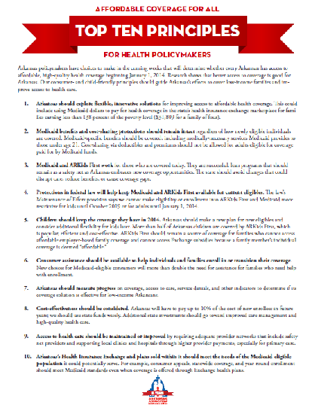
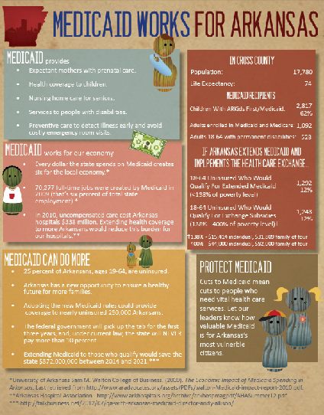
AACF Resources

Slide 14
2015 Legislative Session and Beyond…
Proposed amendments to demonstration waiver
Annual vote on Private Option appropriation
Covering children enrolled in CHIP on Marketplace
Transition to State Based Marketplace
Evaluation of Private Option

Slide 15
Thanks!
Marquita Little, Health Policy Director
mlittle@aradvocates.org
501-371-9678 ext. 119

