Slide 1

Georgia Enrollment Assistance Resource (GEAR) Network:
GEARing up for OE3!
Whitney Griggs & Pranay Rana
October 19, 2015

Slide 2
Overview
GEAR and its purpose
An overview of the site
Tools for direct consumer use
Resources for enrollment assisters
Feedback and questions

Slide 3

Georgians for a Healthy Future
Notes:
Our mission is to build and mobilize a unified voice, vision, and leadership to achieve a healthy future for all Georgians. Our vision is of a day in which all Georgians have access to the quality, affordable health care they need to live healthy lives and contribute to the health of their communities. Each year, we develop public policy priorities to move Georgia closer to this vision. Our three-pronged approach includes: 1) outreach, education & engagement with consumers and communities; 2) building and mobilizing coalitions; and 3) public policy advocacy

Slide 4
What is GEAR?
A central hub of resources for Georgia’s enrollment assisters and community-based organizations to use in their work to educate health care consumers
A one-stop shop for handouts, interactive consumer tools, important assister updates, and other materials, most of which are Georgia-specific
With the goal to help enrollment assisters and community-based organizations better educate Georgians on health insurance enrollment, how to use their insurance, and more.

Slide 5

Why did we create GEAR?
GHF’s “Getting Georgia Covered” report
  Highlighted the successful strategies of enrollment assisters and the challenges and barriers to enrollment that still remain for consumers
Limited health insurance literacy among consumers
Help consumers get enrolled and stay enrolled
Georgia-specific info
Build a community for Georgia’s enrollment assisters to get and share information
One-stop shop for all of your enrollment needs
Notes:
The assisters that we interviewed said that many consumers had never had insurance before, so they did not know how to choose a primary care provider or pay their monthly premium.
Another that we created GEAR, was to provide a community for Georgia’s enrollment assisters to get and share information in a way that has never existed before.

Slide 6
“For the most part, people are understanding that they need to sign up. However the disconnect comes when they have to use the insurance. They may not understand that a cheap plan may mean more costs out of pocket.”
—Atlanta-based enrollment assister, “Getting Georgia Covered”

Slide 7
GEAR Overview: What will it look like?

Slide 8
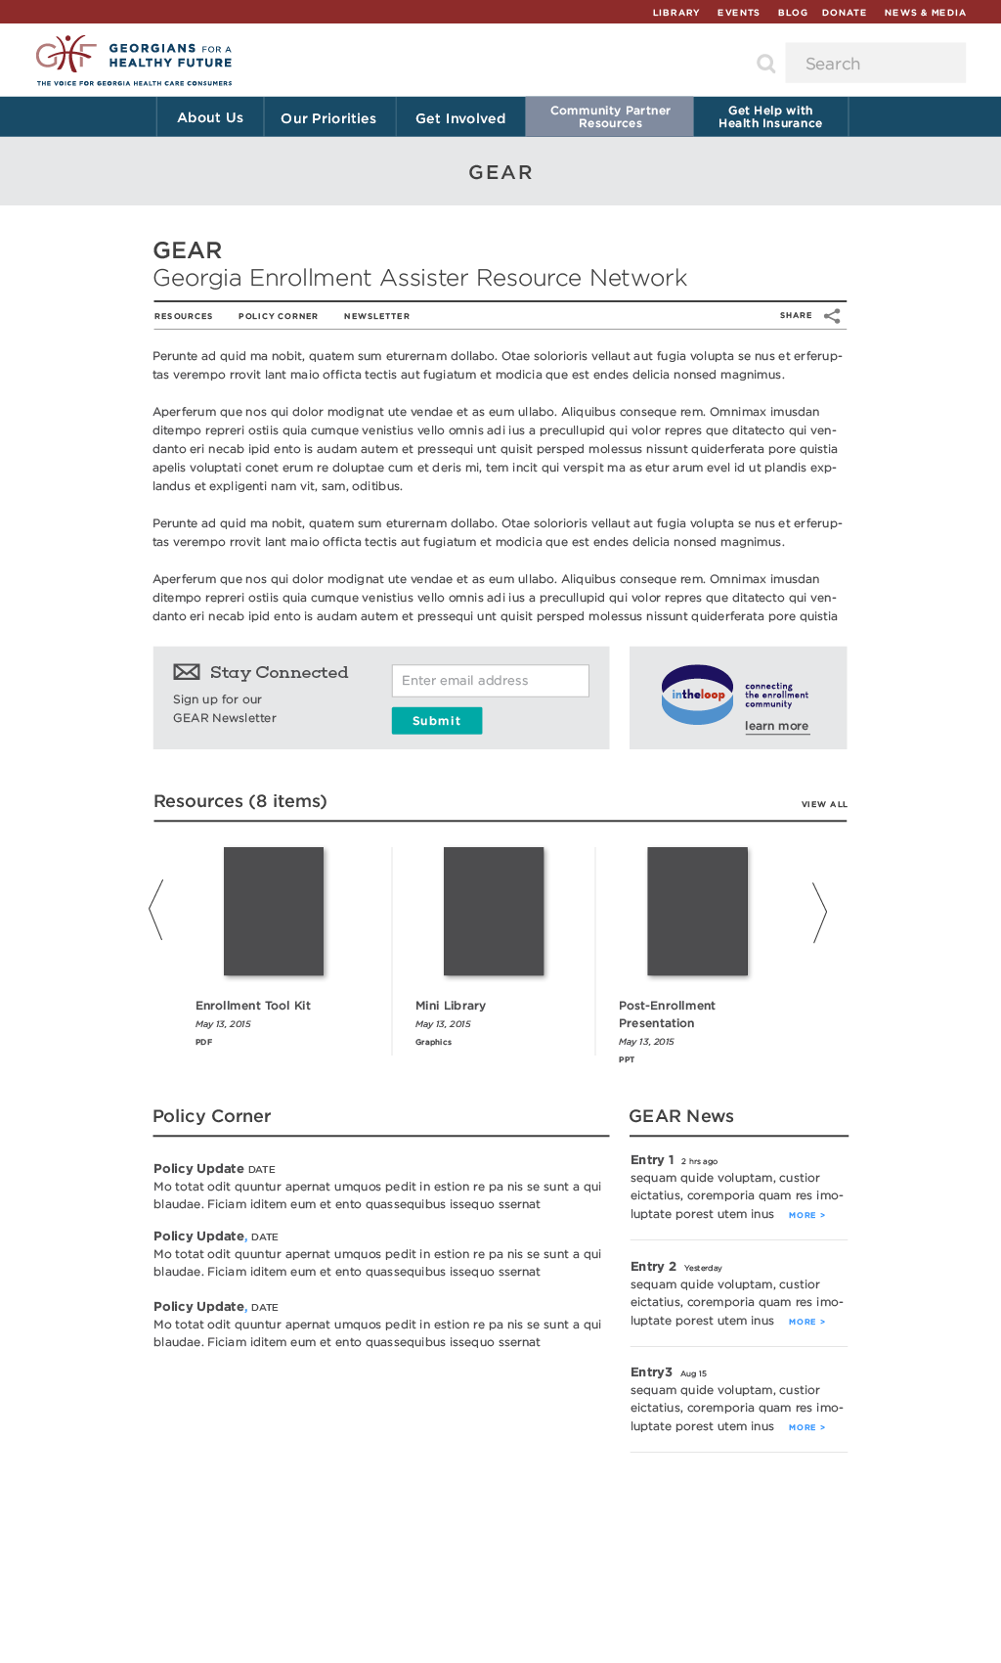

Slide 9
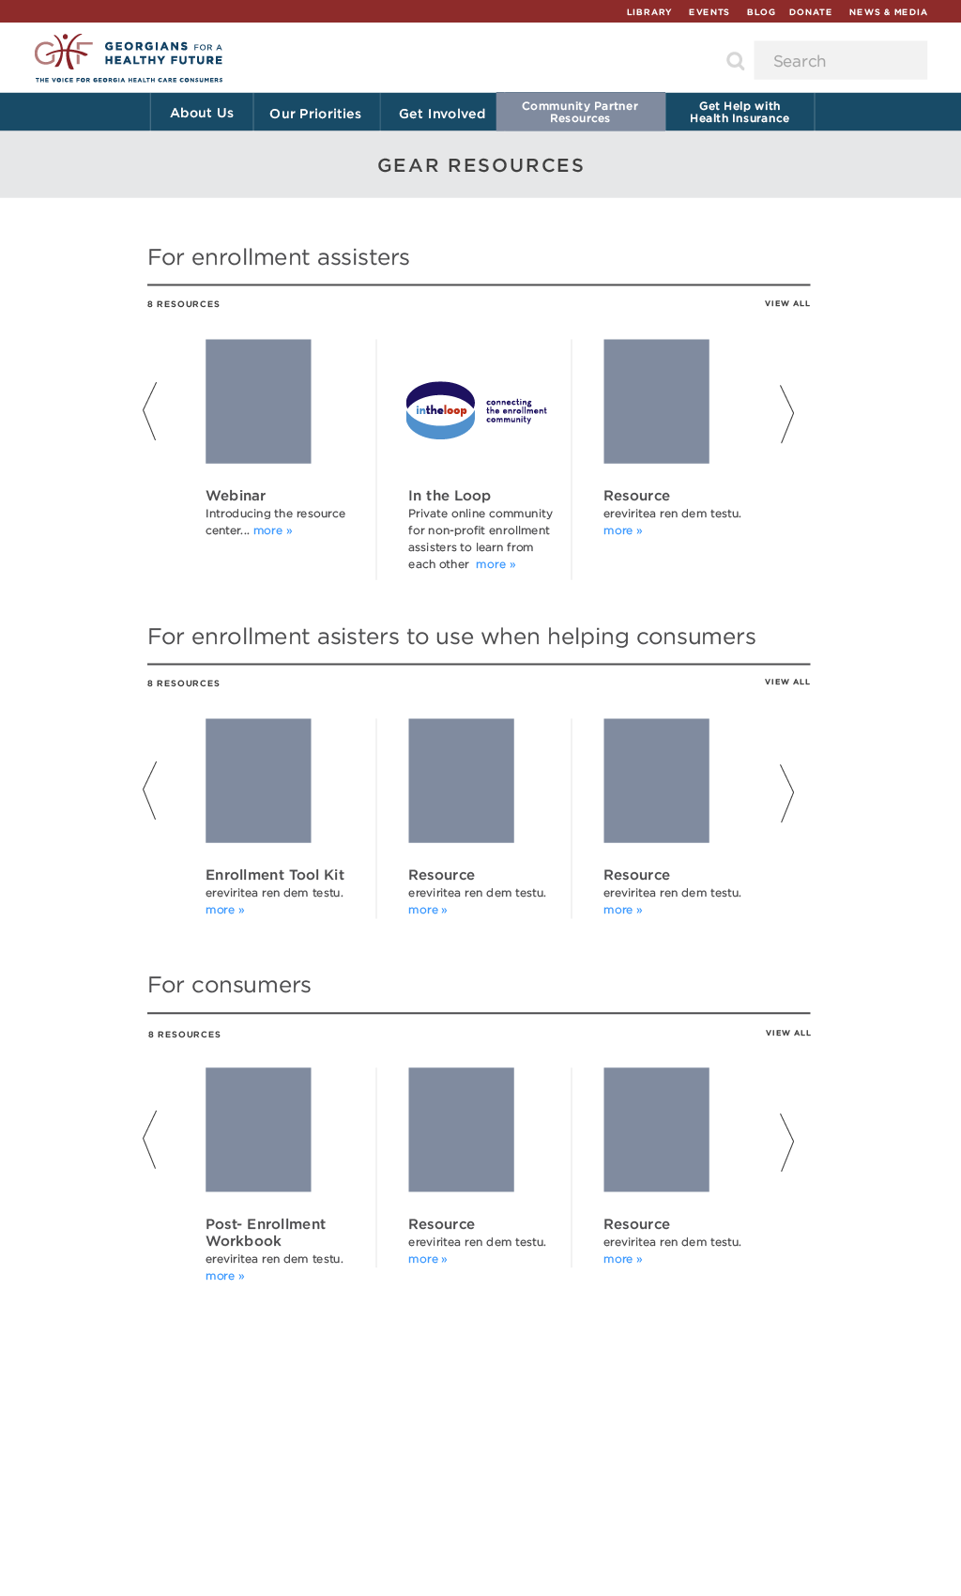

Slide 10
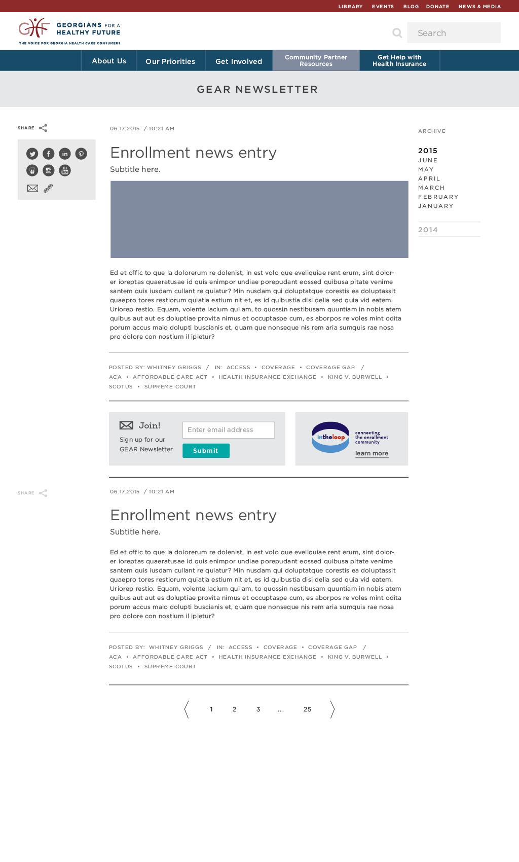

Slide 11
Consumer Tools
Enrollment Toolkit
Consumer Workbook
EA ‘s Get Covered Connector
EA’s Subsidy Calculator
CMS Coverage to Care

Slide 12

Enrollment Toolkit: “Get Insured, Stay Insured”
A comprehensive, Georgia-specific toolkit to walk consumers through each step of the enrollment process, from how to get health insurance (enrollment) to how to use health insurance once they have it (post enrollment)

Slide 13
Toolkit: What’s Inside?
ENROLLMENT TOOLS
POSTENROLLMENT TOOLS
Application Guide
Medicaid in Georgia
How much will health insurance cost you?
Special Enrollment Periods (SEP)
Common Scams & Concerns: Affordable Health Care
Penalties & Exemptions
Enrollment Assistance Exit Form
You’re Covered, Now What?
Finding a Primary Care Provider
Preventive Services
Appeals & Complaints
Health Insurance & Taxes
Employer Coverage & Tax Credits Worksheet

Slide 14
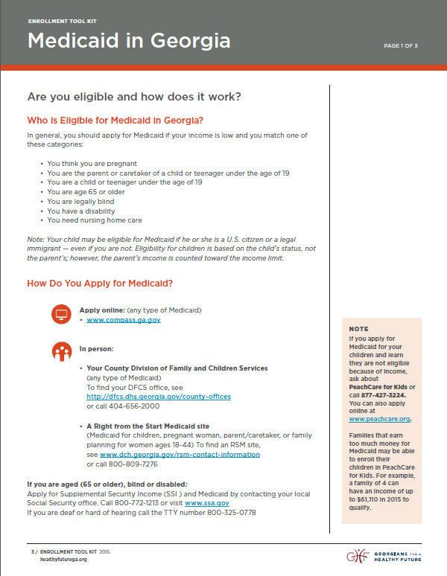

Slide 15
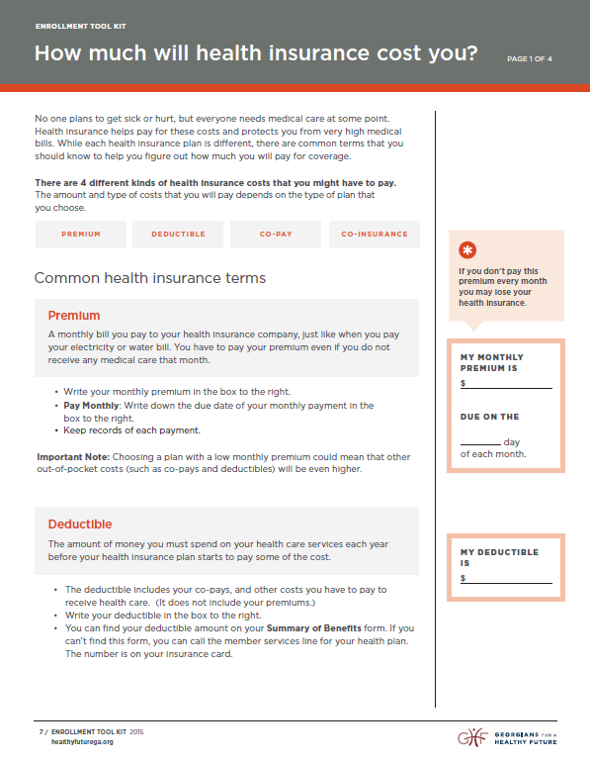

Slide 16
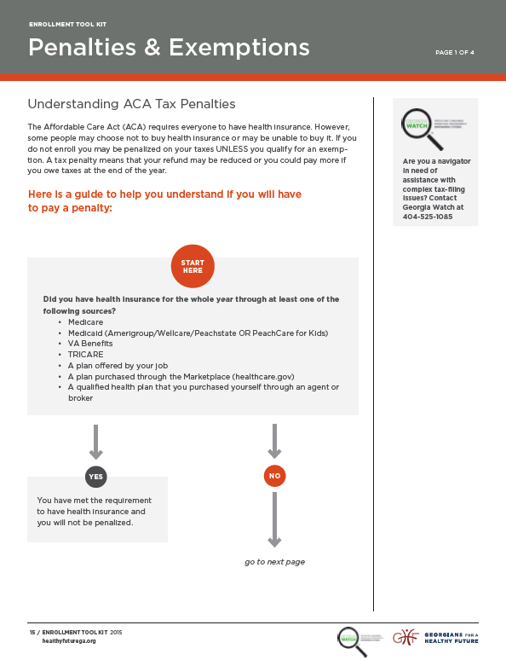
For questions about the ACA and tax filing – reach out to Elise Blasingame at Georgia Watch: eblasingame@georgiawatch.org.
Notes:
We want to especially thank Georgia Watch for their help developing these materials. They are have become experts on the ACA and tax filing.

Slide 17
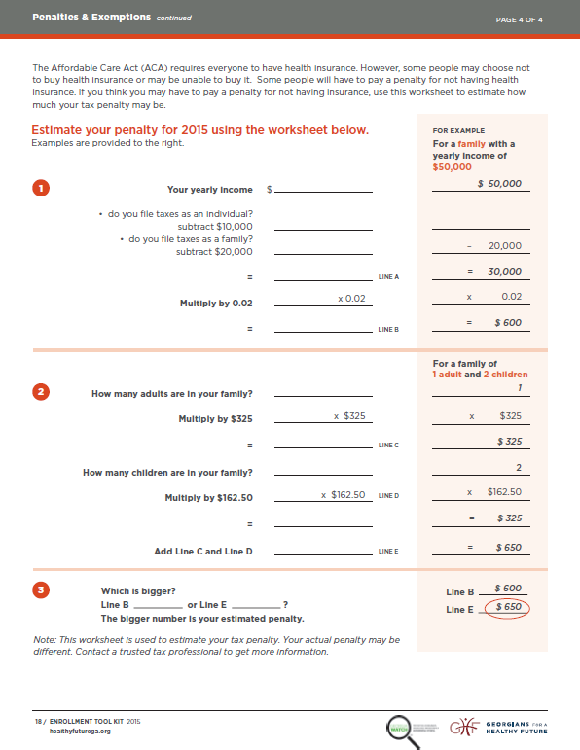

Slide 18
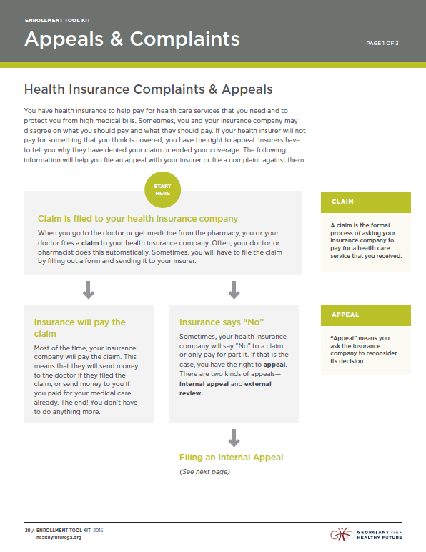

Slide 19
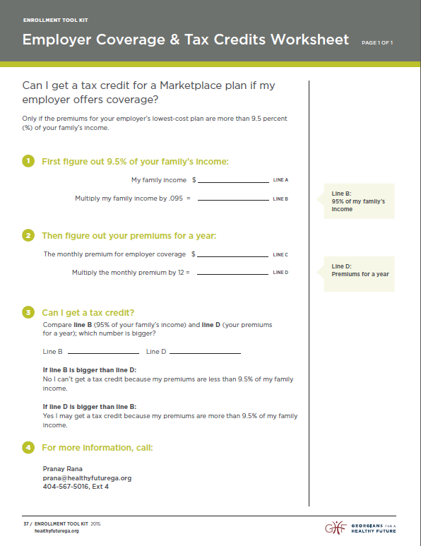

Slide 20


Slide 21

Post Enrollment Workbook
A take-home, interactive booklet for consumers after enrollment
Allows consumers to learn important information that may not get covered during the enrollment appointment
Consumers can fill in their own personal information, such as plan info, doctor’s names, and medications

Slide 22
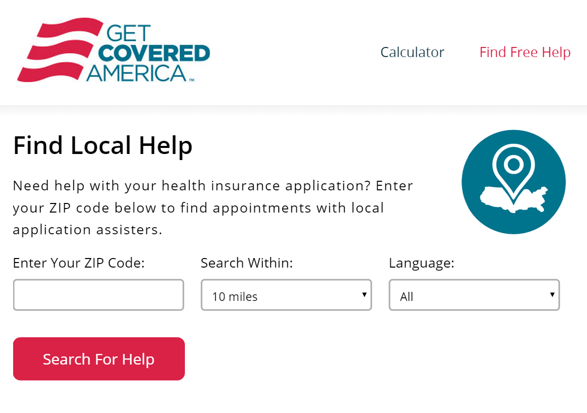
Enroll America’s Get Covered Connector
Find and schedule appointments with local assistance
Appointment reminders
Search for help by ZIP code, review their options, and schedule an appointment
Ability to contact local assisters directly if they have questions or problems

Slide 23
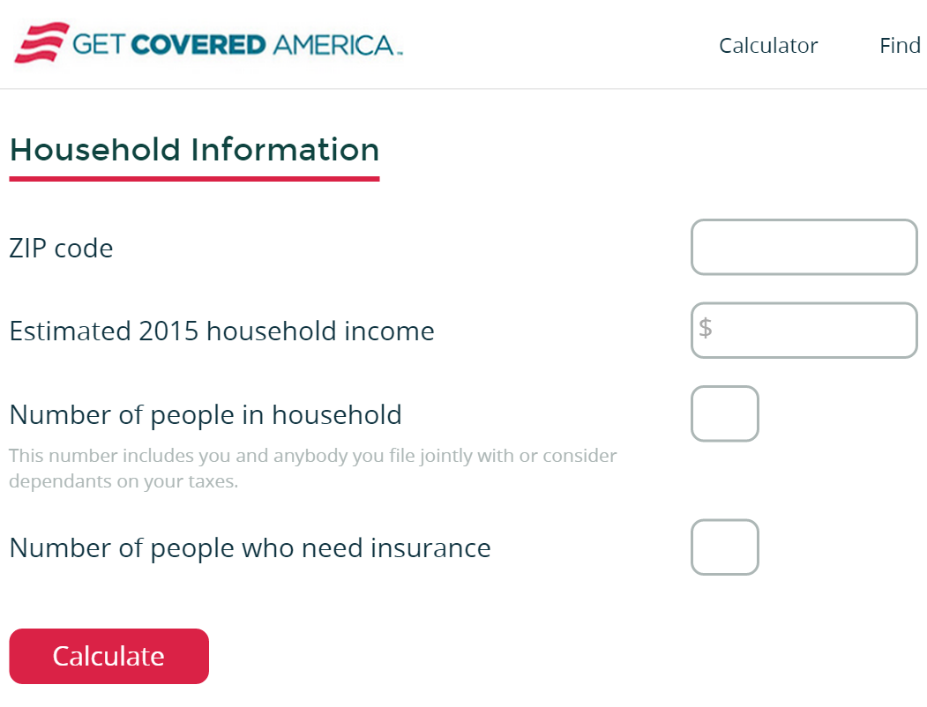
Enroll America’s Calculator
Consumers can easily see how much of a subsidy they may qualify for.
Encourages enrollment
Allows for a better understanding of prices

Slide 24

CMS Coverage to Care
Free materials from CMS
Another resource to help consumers understand their benefits and coverage

Slide 25
Resources for Assisters
Consumers Union
  SBC explanation tool
  Tax Credit tool
  Consumer Health Choices Materials
Families USA Enrollment Assister Resource Center
RWJF Navigator Resource Guide
Center on Budget and Policy Priorities—Beyond the Basics
Putting Patients First Cost Calculator
In the Loop

Slide 26
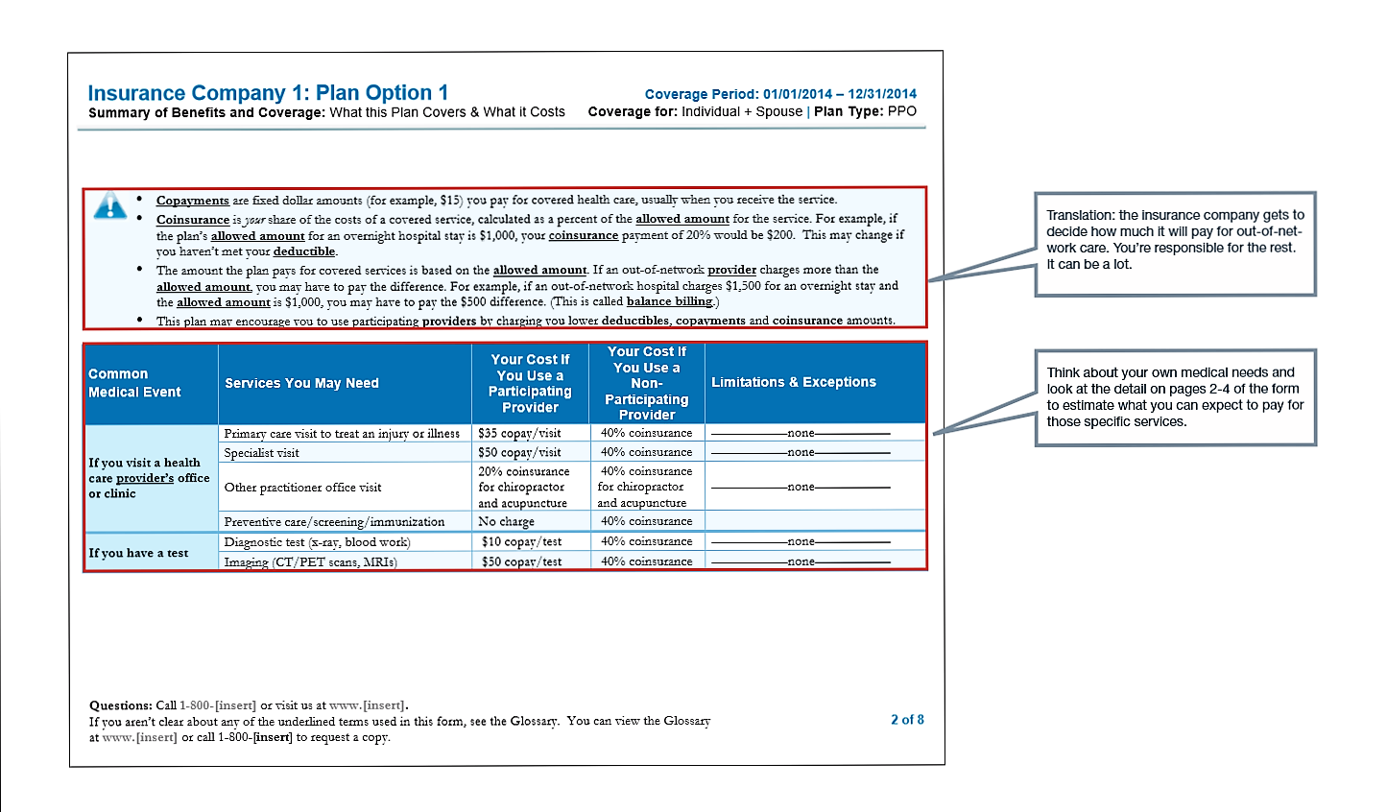
Consumers Union Tools
SBC Calculator
http://www.consumerreports.org/health/resources/pdf/SBCinfo.pdf

Slide 27
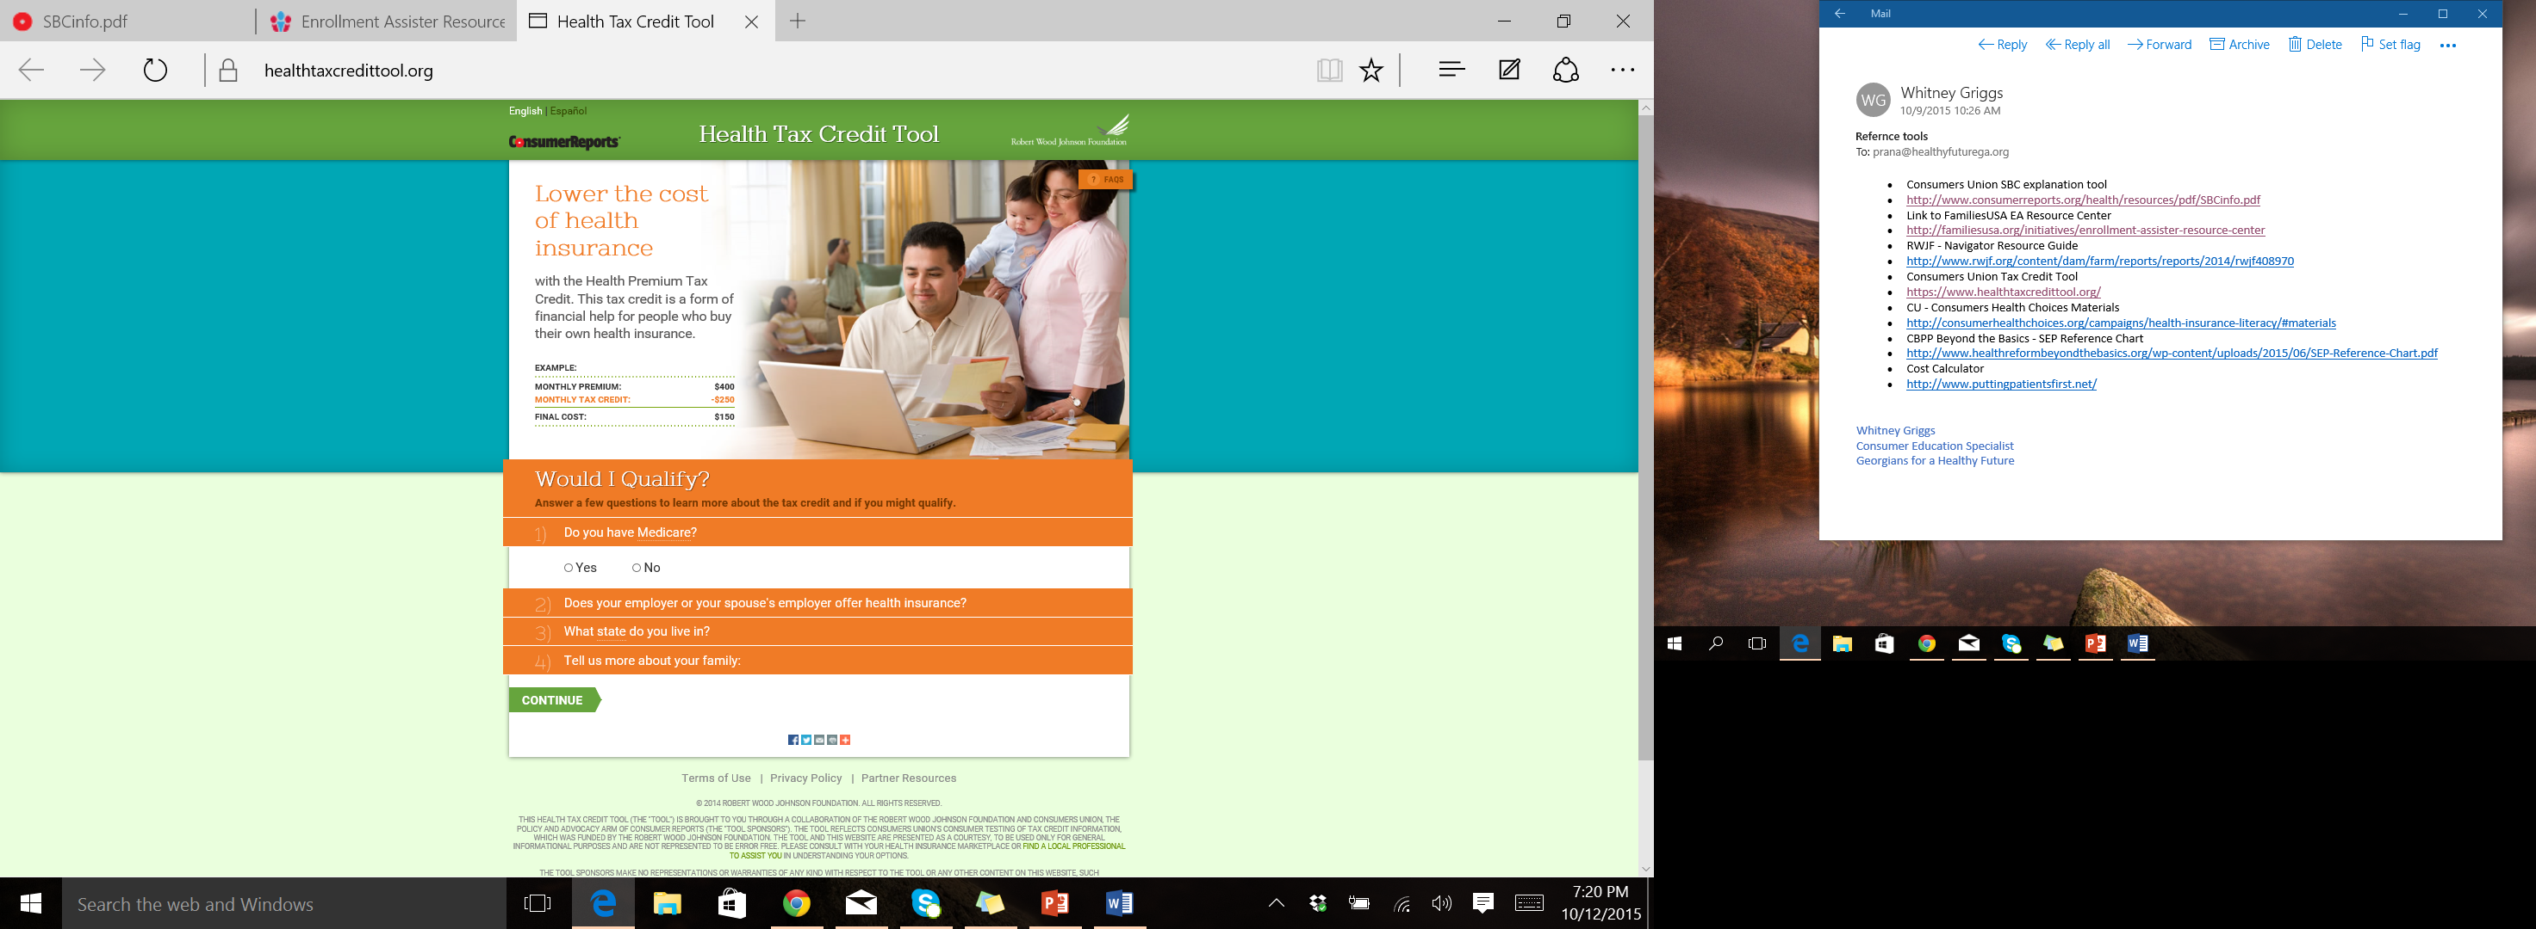
Consumers Union Tools
Tax Credit Tool--healthtaxcredittool.org

Slide 28
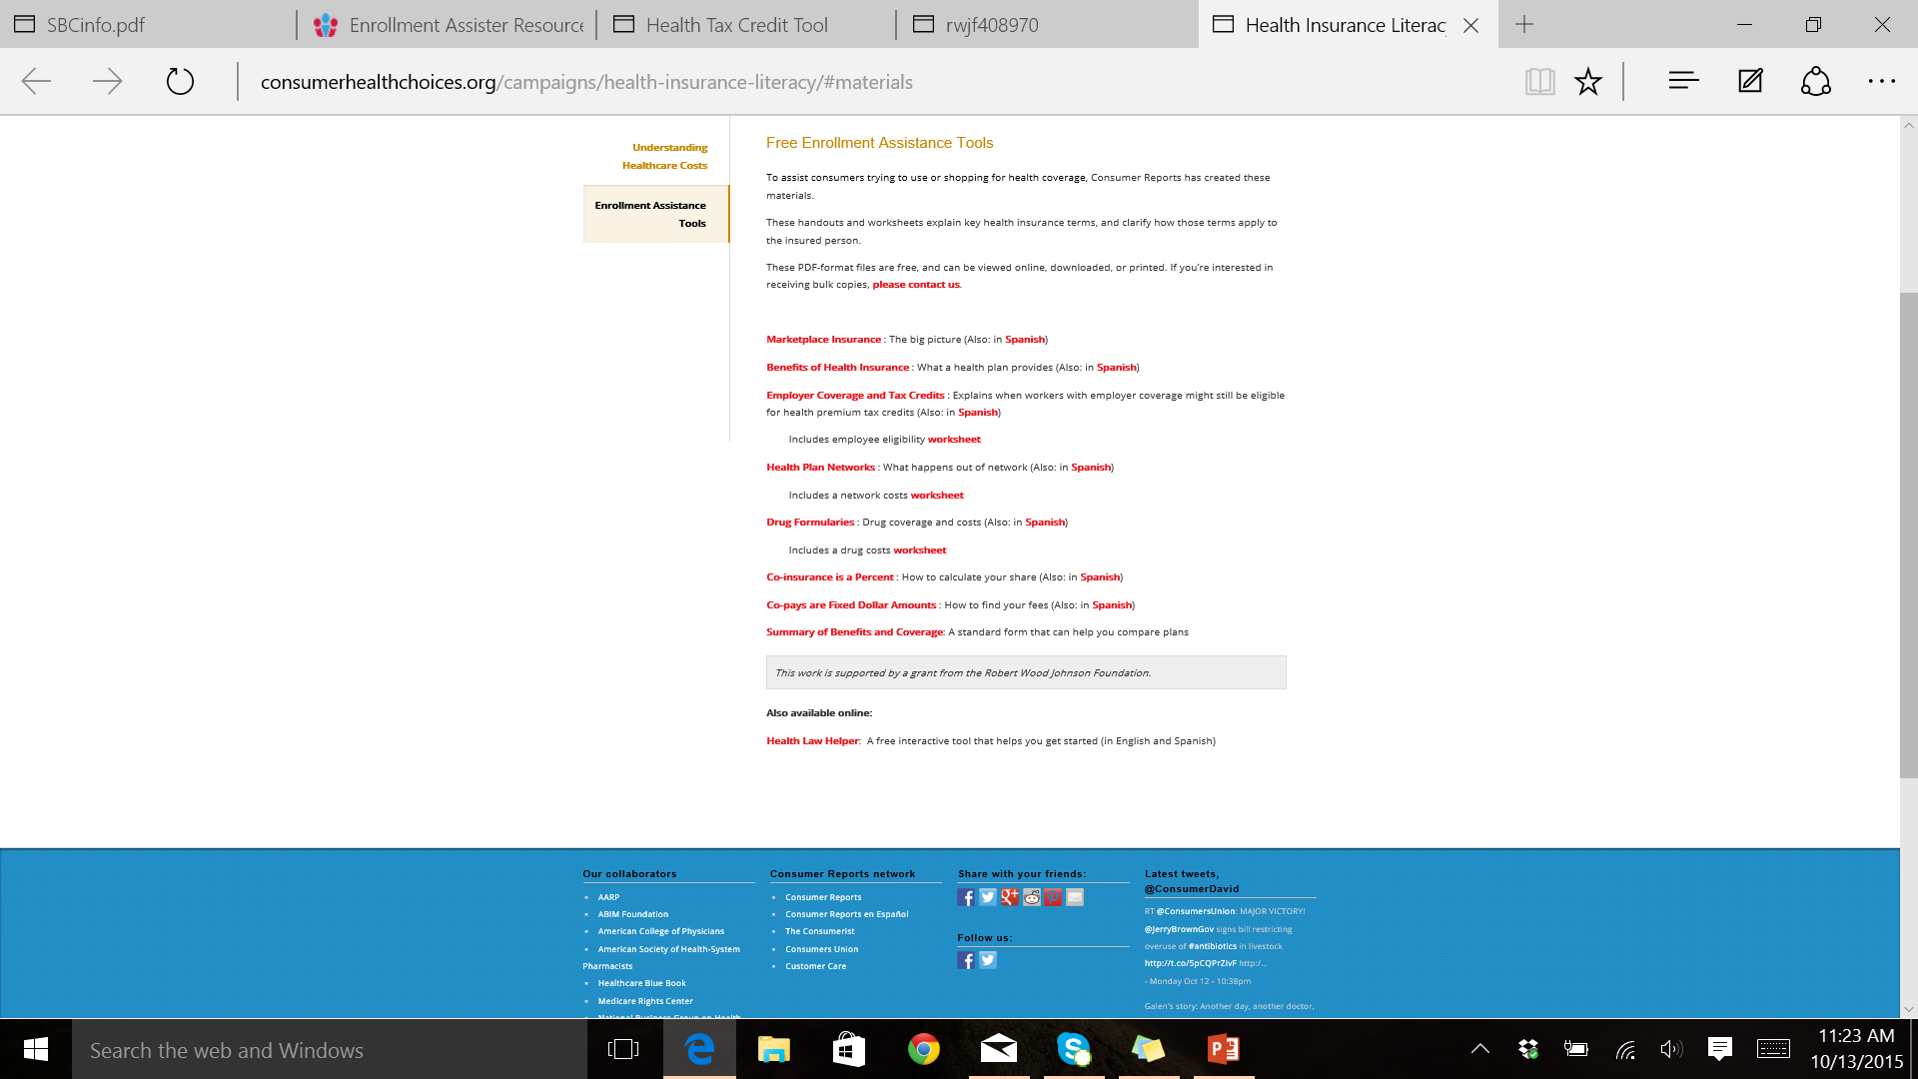
Consumers Union Tools
Consumer Health Choices materials-consumerhealthchoices.org

Slide 29
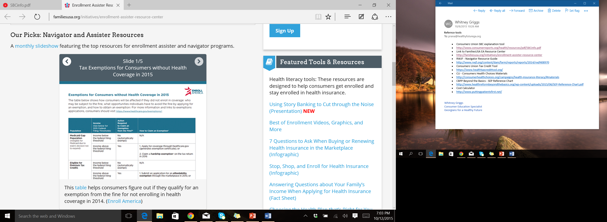
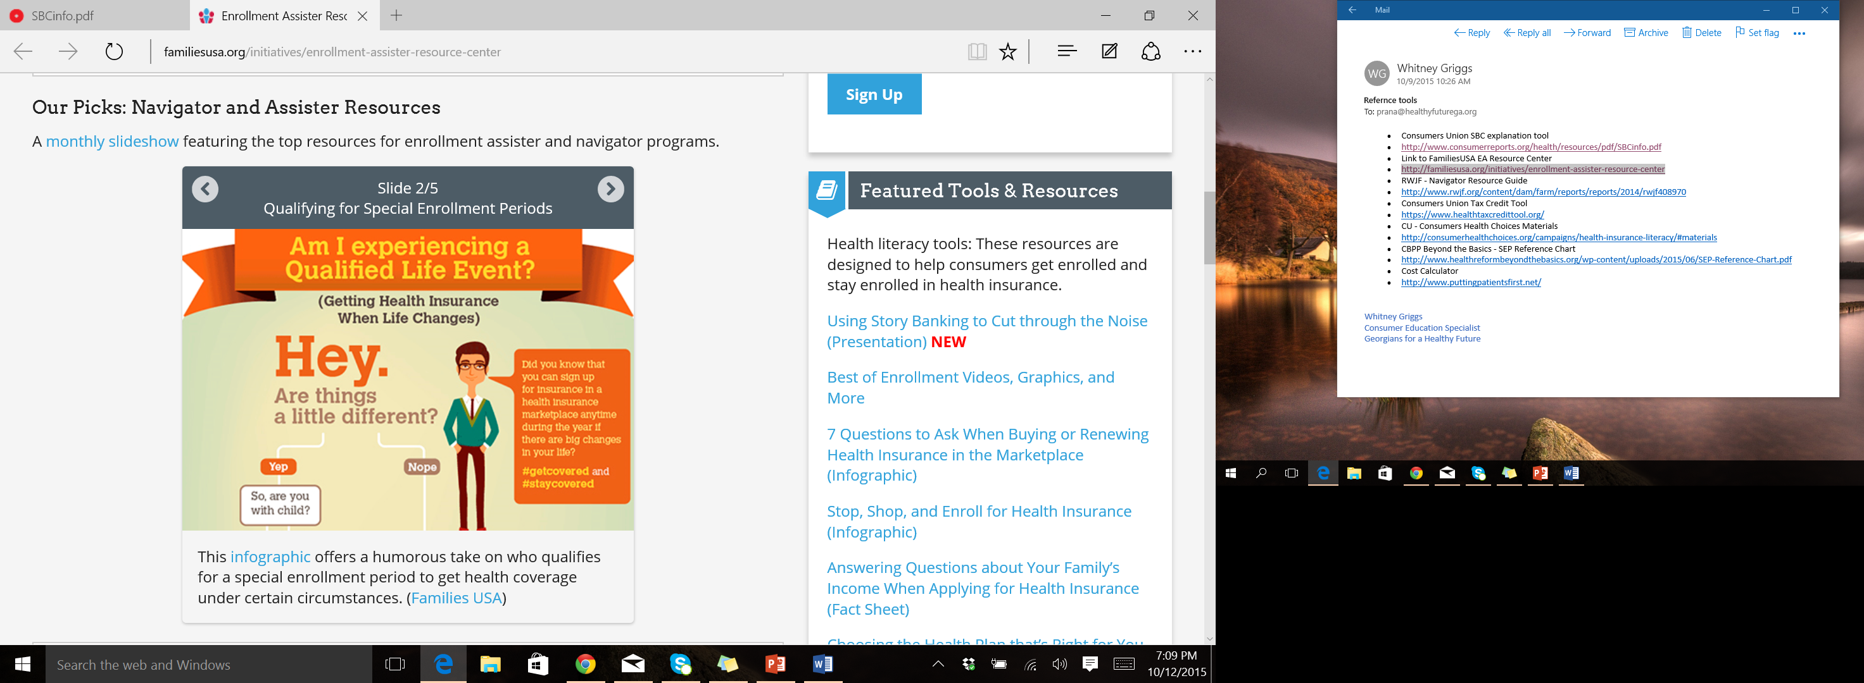
Families USA
Enrollment Assister Resource Center
familiesusa.org/initiatives/enrollment-assister-resource-center

Slide 30
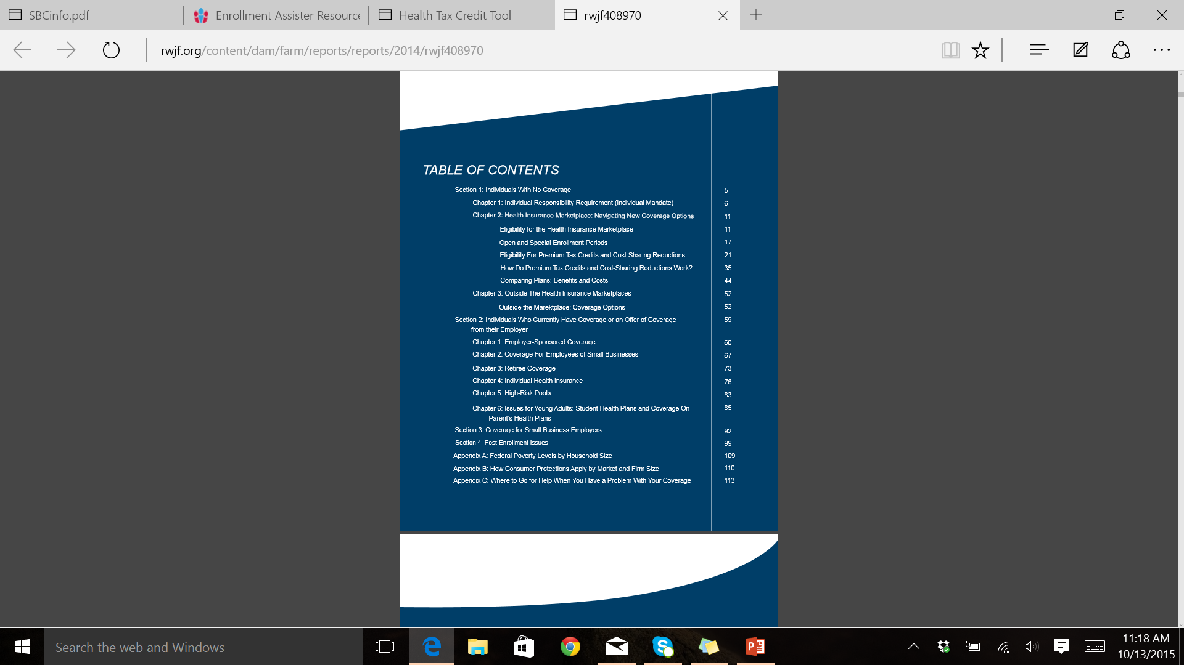
Robert Wood Johnson Foundation
Navigator Resource Guide

Slide 31
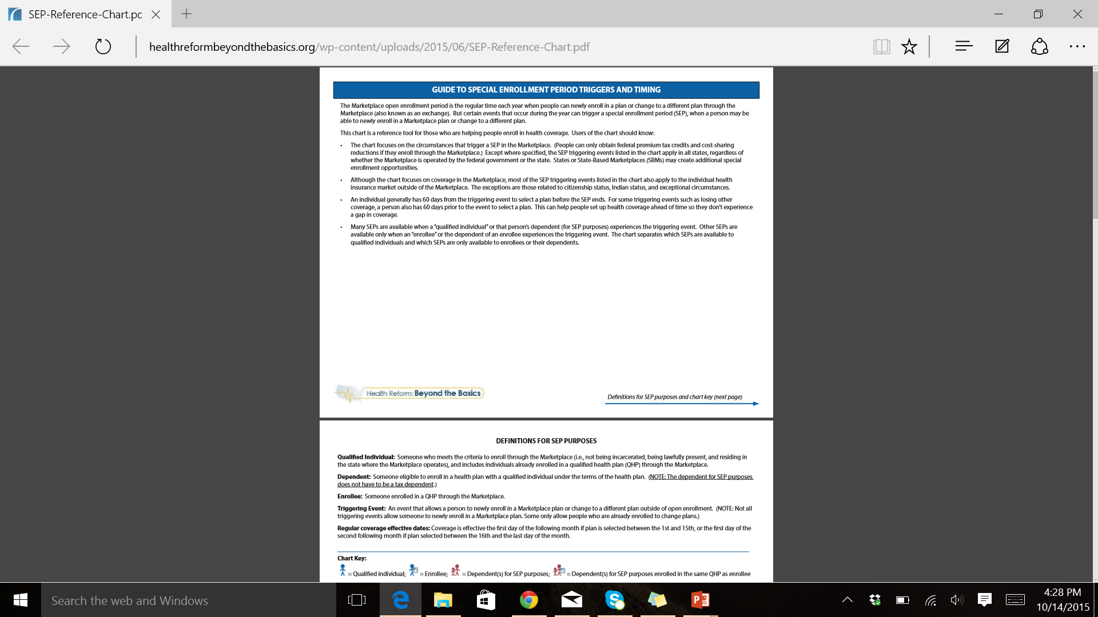
Center on Budget and Policy Priorities
Beyond the Basics SEP Guide

Slide 32
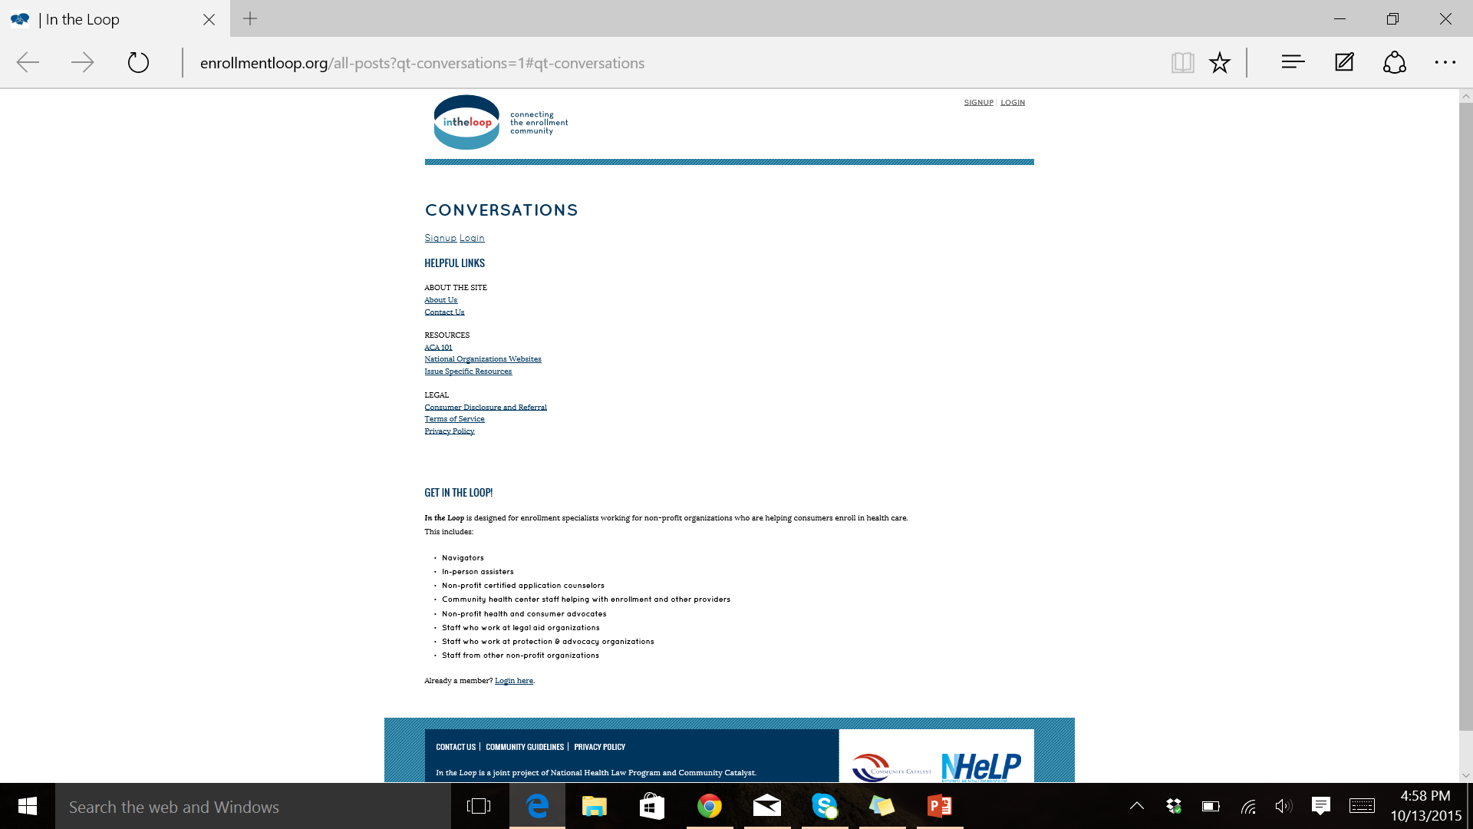
In The Loop

Slide 33
Resources for Assisters
Consumers Union
  SBC explanation tool: consumerreports.org/health/resources/pdf/SBCinfo.pdf
  Tax Credit Tool: https://www.healthtaxcredittool.org/
  Consumer Health Choices Materials:
  consumerhealthchoices.org/campaigns/health-insurance-literacy/#materials
Families USA EA Resource Center
  familiesusa.org/initiatives/enrollment-assister-resource-center
RWJF - Navigator Resource Guide
  rwjf.org/content/dam/farm/reports/reports/2014/rwjf408970
CBPP Beyond the Basics - SEP Reference Chart
  healthreformbeyondthebasics.org/wp-content/uploads/2015/06/SEP-Reference-Chart.pdf
In the Loop
  http://enrollmentloop.org/search/site/georgia

Slide 34
More to Come with GEAR!
Visit GEAR at www.healthyfuturega.org/gear to view resources and stay up to date!

Slide 35

What to expect from GEAR in the future
Weekly emails with a round of up relevant enrollment related information from various sources
Timely webinars on enrollment and post-enrollment topics
!
GHF’s new website!
Launching by the end of the year

Slide 36

We want to hear from you!
Questions & feedback
What resources do you use that we haven’t included?
How can we make it work for you?
What would you like to see?

Slide 37
Thank you!
Contact us!
For questions about GEAR:
Whitney Griggs: wgriggs@healthyfuturega.org
For questions about enrollment, post enrollment, or post-enrollment issues:
Pranay Rana: prana@healthyfuturega.org
404-567-5016
FOLLOW & SHARE
100 Edgewood Avenue, Suite 1015
^{Atlanta, GA 30303}
^{Phone: 404-567-5016}
^{Fax: 404-935-9885}
^{info@healthyfuturega.org}
^{healthyfuturega.org}

