Slide 1
Whitney Griggs
Consumer Education Specialist
Georgians for a Healthy Future

Slide 2
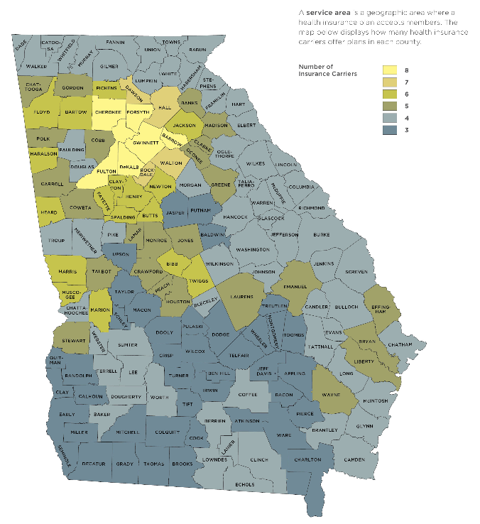
The Health Insurance Marketplace in Georgia
Federally Facilitated Marketplace (FFM)
Healthcare.gov, 1-800-318-259, or in-person assistance from a Navigator or Certified Application Counselor
All plans available to Georgia consumers are offered by Georgia health insurance companies with Georgia-based provider networks

Slide 3
The Health Insurance Marketplace in Georgia
541,080 Georgians enrolled in coverage through the Marketplace
Nearly 9 in 10 qualified for tax credits
The average premium paid for an individual plan after tax credits were applied was $73 per month
55% of enrollees were new to the Marketplace
45% re-enrolled from the previous year

Slide 4
The Role of In-Person Assistance
ACA created an infrastructure and authorized funding for consumer assistance
Increase awareness
Provide unbiased education
Facilitate enrollment
Major funding sources were navigator grants through CMS and grants to Federally Qualified Health Centers (FQHCs)
HHS awarded $3.3 million in navigator grant funding to two organizations
Seedco:$2.2 million
InsureGA: $1.1 million

Slide 5
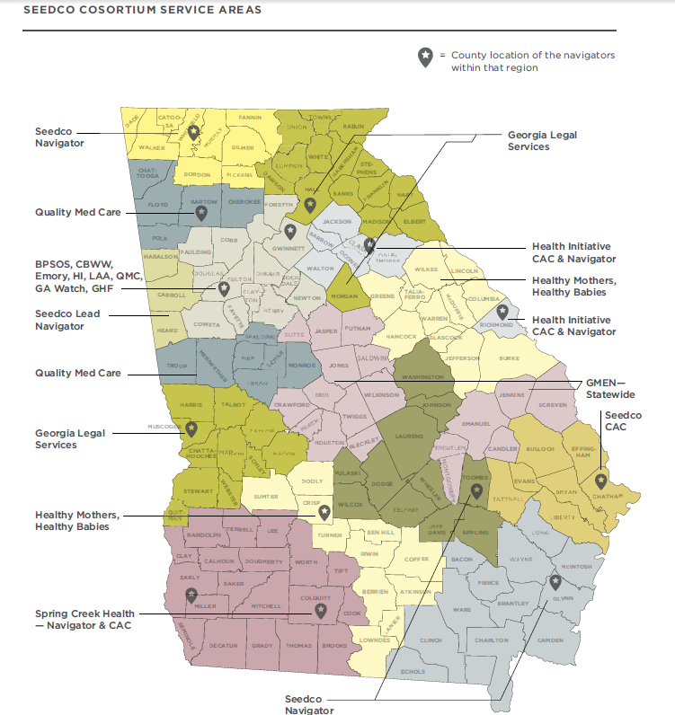
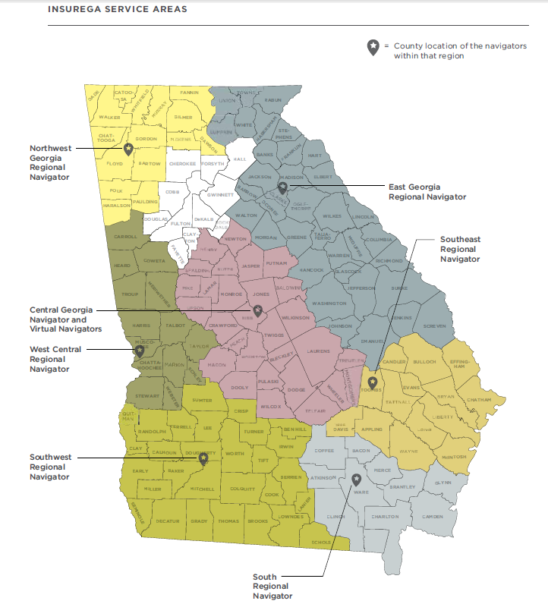

Slide 6
Best Practices and Lessons Learned: Results from in-depth interviews with and survey of enrollment assisters
Notes:
For the issue brief we asked enrollment stakeholders to complete a 39 item survey developed by GHF. Respondents answered questions about their organization and the services provided, the barriers and facilitators of enrollment in their communities, consumers’ ability to use their new coverage and policy recommendations to support enrollment and consumer use of coverage.
In addition the surveys, I also conducted in-depth interviews with 10 enrollment assisters from various community organizations. Assisters were asked to discuss both successful enrollment strategies, and barriers and challenges to enrollment that consumers faced. The following best practices and lessons learned are take from this feedback.

Slide 7
Successful Strategies and Best Practices
Using a variety of local venues to conduct extensive outreach
Libraries, churches, Volunteer Income Tax Assistance (VITA) sites, doctor’s offices, community health centers, cooperative extensions, small businesses, AIDS service organizations and local hospitals
Leveraging the support of existing partnerships for outreach
One of the best methods for reaching consumers was building upon existing relationships with community organizations
Developing trust with consumers
Being recognized as a trusted resource within the community was one of the most critical aspects
Reaching large numbers of people through events and local media
Large scale enrollment events, marketing in local media using radio spots, newspaper ads, and movie theater ads

Slide 8
Challenges that remain for consumers
Many consumers had limited health insurance literacy
More than 2/3 of survey respondents identified low health insurance literacy as a barrier to enrollment
Many consumers fell into the coverage gap
Some assister organizations estimated that over half of the consumers that they worked with fell into the gap
Immigrants faced verification and language barriers
Identity verification issues were reported as the biggest barrier to enrollment for immigrants
Key terms and concepts associated with health insurance do not translate well in other languages
Confusion and political opposition to the ACA hindered partnerships
HB 943, “Health Care Freedom Act,” passed in 2014, prohibiting state and local government agencies from operating a navigator program
This led to confusion among health departments and other government agencies about their participation in enrollment assistance

Slide 9
What Are the Next Steps in Consumer Assistance?
Best Practice and Policy Recommendations

Slide 10
Post-enrollment consumer needs
More post-enrollment consumer-focused information, materials, resources, and services are needed.
Suggested solutions:
DOI could consider developing a more robust-consumer facing page on its website with consumer tools.
A layered consumer follow-up plan utilizing several stakeholders could address the lack of post-enrollment support. For example:
Automatic emails from the Marketplace
Insurers could send an accurate, updated list of providers based on the consumer’s location
Enrollment assisters could follow-up with consumers that indicate they would like in-person post-enrollment assistance

Slide 11
Reaching the Remaining Uninsured
More than 1 million Georgians are estimated to be eligible for health insurance through the Marketplace
Almost half of this population remains uninsured
Language barriers, a lack of understanding of health insurance, and lack of awareness about the Marketplace were each cited as possible causes
Outreach and education in underserved communities will continue to be important for reaching the uninsured
The Connector, Enroll America’s scheduling tool, may be able to help reach these populations
Lack of an affordable health insurance option for Georgians that fall into the coverage gap complicates the ability to reach the remaining uninsured
Notes:
Many Georgians who are potentially eligible for affordable health insurance remain uninsured and face barriers to enrollment that will require tailored approaches to outreach, education, and enrollment assistance

Slide 12
Policy Recommendations
Notes:
Some of the barriers that consumers faced are best addressed through widespread adoption of best practices around outreach and education, three major barriers would be best addressed through public policy emerged in our review of OE2.

Slide 13
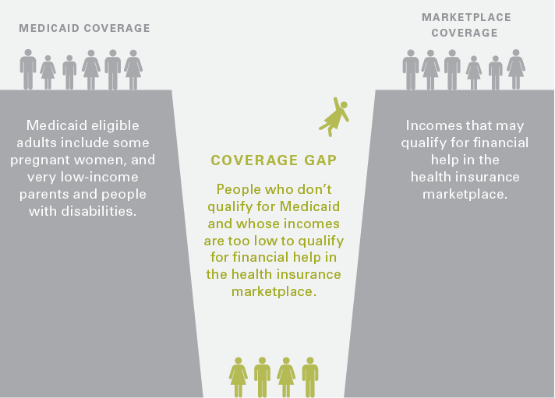
Close the Coverage Gap
300,000 Georgians fall into the coverage gap
They do not qualify for Medicaid under current eligibility guidelines, but their income is too low to qualify for premium tax credits (below 100% FPL)
States that have closed their coverage gap have seen promising results
Notes:
100:% FPL: $11,770 for an individual and $24,250 for a family of 4

Slide 14
Set and enforce network adequacy and transparency standards
There is no information available about the narrowness of the network and provider directories are routinely inaccurate.
More transparency and oversight are needed to ensure consumers have accurate and useful information.
Putting in place and enforcing network adequacy standards would ensure that all provider networks allow for meaningful access to covered benefits
Notes:
Many of the plans sold on the Marketplace are HMOs with narrow provider networks. These narrow networks keep premiums down but consumers do not have enough information to make an informed choice about the tradeoff.

Slide 15
Encourage public-private partnerships and remove unnecessary restrictions on consumer education and assistance
Reducing barriers to partnering with state government organizations would lead to stronger and more effective partnerships
Improved coordination between the Marketplace and the Georgia Department of Community Health would better facilitate PeachCare and Medicaid enrollment
The restrictions put in place by HB 943 should be lifted

Slide 16
Conclusion
The best practices, approaches, and policy recommendations identified can help Georgians stay covered and use their coverage effectively
There is still work to be done to reach the remaining uninsured and to ensure that all Georgians have a pathway to affordable coverage
GHF looks forward to working with stakeholders throughout the state to maximize health insurance enrollment, retention, and ensure a positive experience for all Georgia health care consumers

