Slide 1
Connecting Georgians to Coverage
Seedco
Lisa Stein, Vice President
Work and Family Supports

Slide 2
Introduction to Seedco
Seedco is a national nonprofit organization that advances economic opportunity for people, businesses and communities in need.
We have offices in Georgia, Maryland, New York and Tennessee
Program Areas
Workforce
Work and Family Supports (Benefits)
Technical Assistance
Relevant experience prior to first open enrollment
CHIPRA, SNAP, Facilitated Enrollment for Medicaid contracts
From 2006 through 2014, Seedco’s GA EarnBenefits network assisted over 18,000 households to receive an estimated $32.8 million worth of benefits.

Slide 3
Seedco Navigator Program
We are both a Navigator funded and Certified Application Counselor sponsoring entity in GA, TN, NY, and MD.
Georgia and Tennessee - We were one of two organizations in each state awarded to serve the entire state.
New York City – Serving five boroughs with an emphasis on Brooklyn.
Maryland - Serving 7 counties of the Upper Eastern Shore.
Notes:
Intermediary Model – Seedco works with community partners who have strong affinity group relationships (LGBT, immigrant populations, young invincibles, non-English speaking).
New York City – Serving five boroughs with an emphasis on Brooklyn. Seedco was 1 of 22 organizations awarded to serve a combination of the 5 boroughs.
Maryland - Serving 7 counties of the Upper Eastern Shore. Seedco was 1 of 6 organizations selected to cover the state by region.
Georgia and Tennessee - We were one of two organizations in each state awarded to serve the entire state.

Slide 4
Lessons Learned From OE1
Seedco funded a research study conducted by the University of Georgia, Center for Health & Risk Communication.
Some key findings:
Low Awareness of Navigators
Consumers Appreciated In-Person Assistance
Navigators can Overcome Negative Pre-conceptions
Notes:
Seedco had its own “lab” state and federally funded exchanges, Medicaid and non Medicaid expansion, urban and rural,
Took the opportunity to contract research conducted by University of Georgia, Center for Health & Risk Communication, in all four states Seedco operated. Evaluated data collected, interviewed consumers and Navigators in each state where we operated.
Low Awareness of Navigators - People who came to Navigators after difficulties enrolling independently, most had never heard of the Navigator role or did not know Navigators provide free and impartial service.
Consumers Appreciate In-Person Assistance - Navigators are key facilitators in the enrollment process and often are the only “human face” that consumers encounter on the pathway to insurance enrollment.
Navigators can Overcome Negative Preconceptions: According to some consumers with doubts about health insurance reform, the unbiased, professional attitude and personal approach that they experienced during navigation changed their views.
The full report is available at www.seedco.org/UGANavigatorReport

Slide 5
Key Factors Making OE2 Successful
Continuity
Fast Implementation
Community Relationships
Infrastructure
Technology
Communication
Notes:
Continuity- Majority of partners and navigators were also involved in OE1- this continuity was critical.
Fast Implementation - Seedco managed coalitions of partners to hire staff, organize training and obtain certification per the federal government and Georgia’s own requirements.
Community Relationships – Consortium of diverse partners to achieve the required geographic and affinity group diversity that were priorities for our Navigator programs.
Infrastructure – Seedco’s intermediary model allowed for local flexibility to respond to on the ground need while national coordination allowed for real time sharing of best practices and course correction as needed.
The web portal and the call center were much more stable and prepared for volume this period.
More communication regarding the role and purpose of Navigators and where to find in person assistance.

Slide 6
Key Partners in Second Open Enrollment
Boat People SOS*
Center for Black Women’s Wellness*
Emory-Grady Urban Health Initiative*
Georgia Legal Services
Georgia Micro Enterprise Network
Georgia Watch*
Georgians for a Healthy Future*
The Health Initiative (with Georgia Equality)*
Healthy Mothers Healthy Babies Coalition*
Latin American Association*
Quality Med-Care Inc.*
Spring Creek Health Cooperative*
Notes:
The strategy for Seedco was to have Navigators be mobile out in the community in trusted points of entry that were not limited to just health care points of access.
Geographic and affinity diversity were key elements in partner selection.
Four partners did not continue in Year 2, we brought on 2 new partners. Starred organizations were our returning partners.

Slide 7
Where Our Navigators and CAC’s Were Located Second Open Enrollment

Slide 8
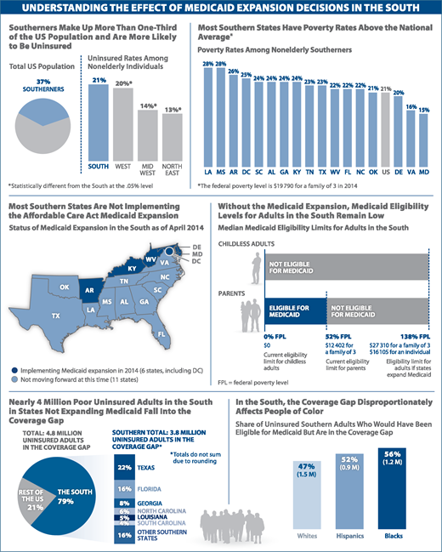
Challenge 1: Medicaid Gap
Notes:
Source: Kaiser Family Foundation (http://kff.org) analysis. Original data and detailed source information are available at http://kff.org/jama_062514.
The South makes up the largest percentage of folks likely to be uninsured
GA has third highest rate for numbers of individuals falling into the Medicaid gap

Slide 9
How We Addressed This Challenge
With generous support from Community Catalyst, Seedco utilized a multi-benefit approach with CAC’s using our EarnBenefits technology tool.
Consortium Navigators also had referrals to reduced cost and free health clinics throughout the state, sorted by zip code.
Notes:
Seedco has a history of doing multi-benefit outreach and enrollment in Georgia. We made sure to have staff at most enrollment events throughout the state who could use our on line technology tool, EarnBenefits, and we screened individuals who fell into the Medicaid gap for other income supports as well as provided a free discount prescription drug card.
Consortium Navigators also had referrals to reduced cost and free health clinics throughout the state, sorted by zip code for easy referral
We are grateful for the support of Community Catalyst, with funding provided by Robert Wood Johnson, which allowed Seedco to enhance its network with CAC’s who could both enroll consumers in the marketplace as well as in other income supports and benefits.

Slide 10
Challenge 2: Low Health Insurance Literacy
At least 4 in 10 of the uninsured can't identify the definitions of "premiums," "deductibles," or "provider network.”
Individuals with low health literacy average $13,000 in annual health costs vs. $3,000 for those with high health literacy.
Low health literacy costs the U.S. economy between $106-$238 billion annually.
Notes:
1- KFF
2-Healthcare IT News
3- George Washington University

Slide 11
How We Addressed This Challenge
Supplemental training to state and federal curriculum
Visual Tool Created
Notes:
Seedco incorporated interactive health insurance literacy communications training into its supplemental Navigator training. Navigators practiced with a health literacy communications expert, translating terms like “household”, “co-payment”, and “provider network” into easily understandable phrases,
Don Rubin, Principal with Visual Remedies, worked with Seedco to develop a health insurance literacy visual handbook for Navigators to utilize while explaining difficult concepts to consumers.

Slide 12
Successful Outreach and Enrollment Strategies
Navigator partners are grounded in the communities and populations we want to reach
Events co-sponsored/ hosted by local churches, trusted community based organizations and local leaders
Advertising in local radio/newspapers, especially in rural areas
Navigators are themselves reflective of the communities we want to reach
Notes:
New outreach strategies- movie theatres along with radio and local paper placements week leading up to event
12 out of 24 are African American
5 out of 24 are Hispanic
5 out of 24 are White
1 out of 24 is Asian
1 out of 24 identifies as Other
# of Events Attendance
398 15,549

Slide 13
Dashboard for OE2

Slide 14
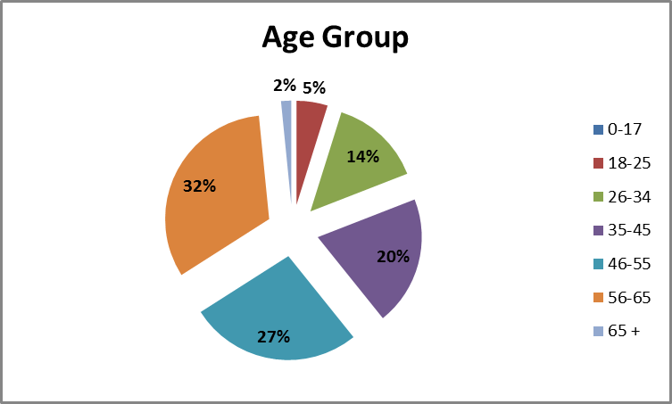
Demographic Data

Slide 15
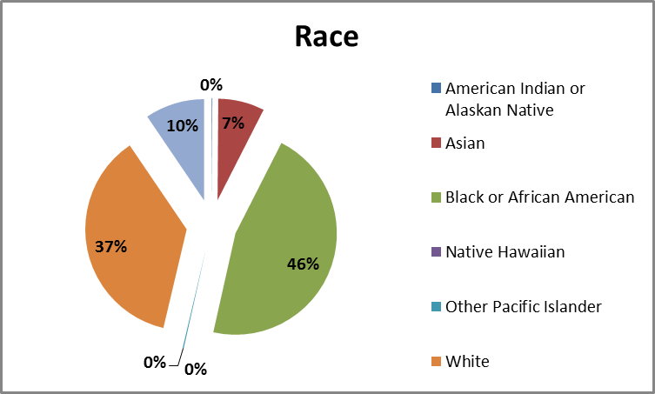
Demographic Data

Slide 16
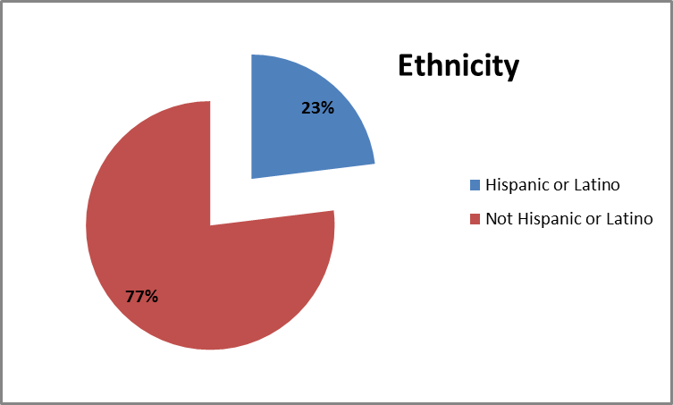
Demographic Data

Slide 17
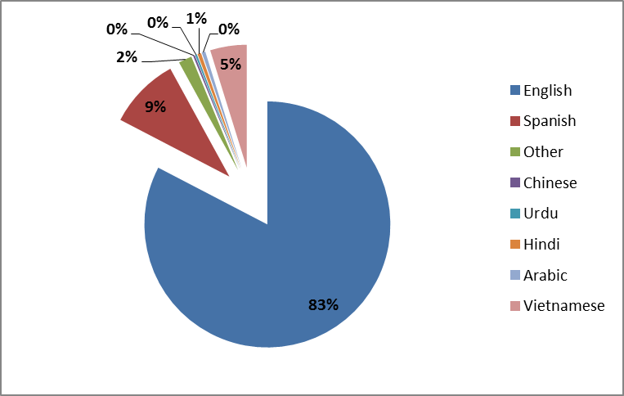
Demographic Data
Preferred Language

Slide 18
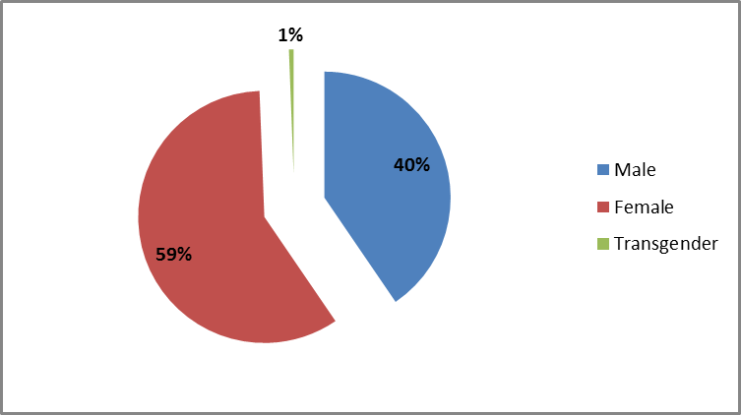
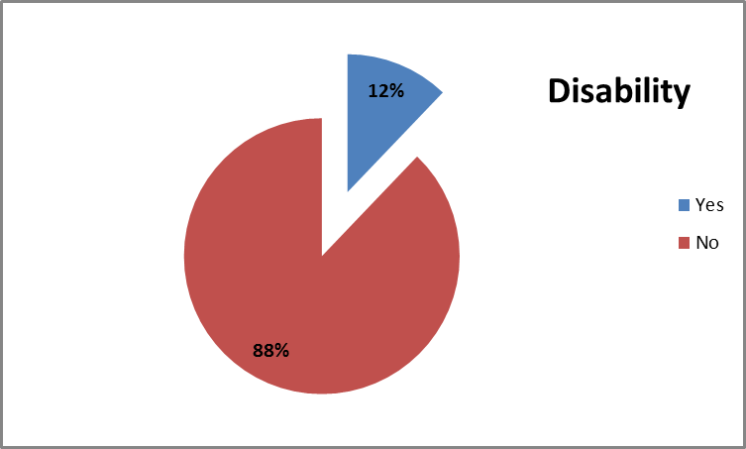
Demographic Data
Gender

