Slide 1


Your Health, Your Choice: Guide to the Marketplace
Nykita Howell
Health Insurance Navigator

Slide 2
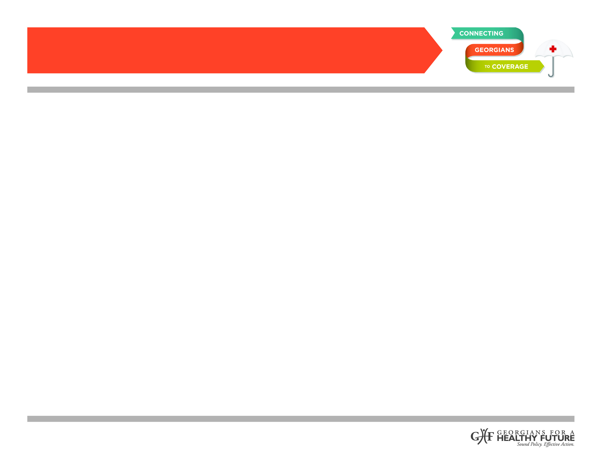

What is the Affordable Care Act?
The Patient Protection and Affordable Care Act (PPACA),commonly called the Affordable Care Act (ACA) or Obamacare,is a United States federal statute signed into law by President Barack Obama on March 23, 2010.
The ACA aims to increase the quality and affordability of health insurance, lower the uninsured rate by expanding public and private insurance coverage, and reduce the costs of healthcare for individuals and the government.

Slide 3
How does ACA affect consumers?
The Affordable Care Act increases access to health coverage for consumers through:
Access to certain free preventive services
Health coverage for pre-existing conditions
Access to health coverage through the Marketplace
Health coverage for young adults up to age 26 on their parents’ health plan

Slide 4
How does ACA affect insurance companies?
The Affordable Care Act protects consumers by changing requirements for health insurance companies.
Health insurance companies must:
Help consumers understand their coverage
  Summary of Benefits
  Glossary of Terms
Refrain from canceling health coverage after they’ve already agreed to cover consumers
Offer certified health plans
  Qualified Health Plans (QHPs)
Offer a guaranteed set of benefits
  Essential Health Benefits (EHBs)
Not have limits on lifetime coverage

Slide 5
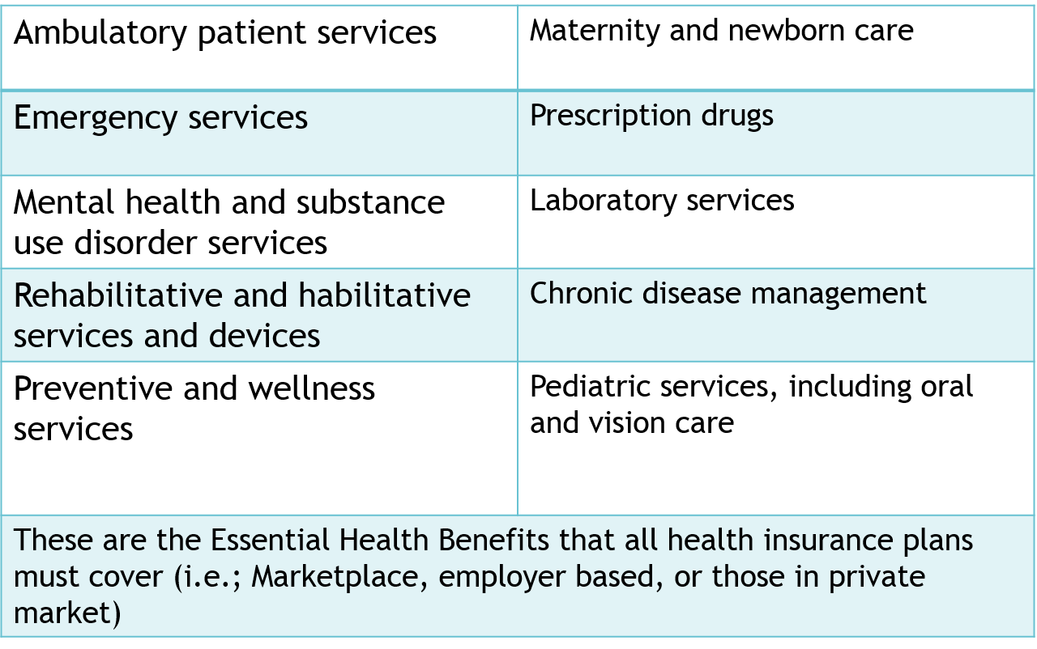
What are the Essential Health Benefits?

Slide 6
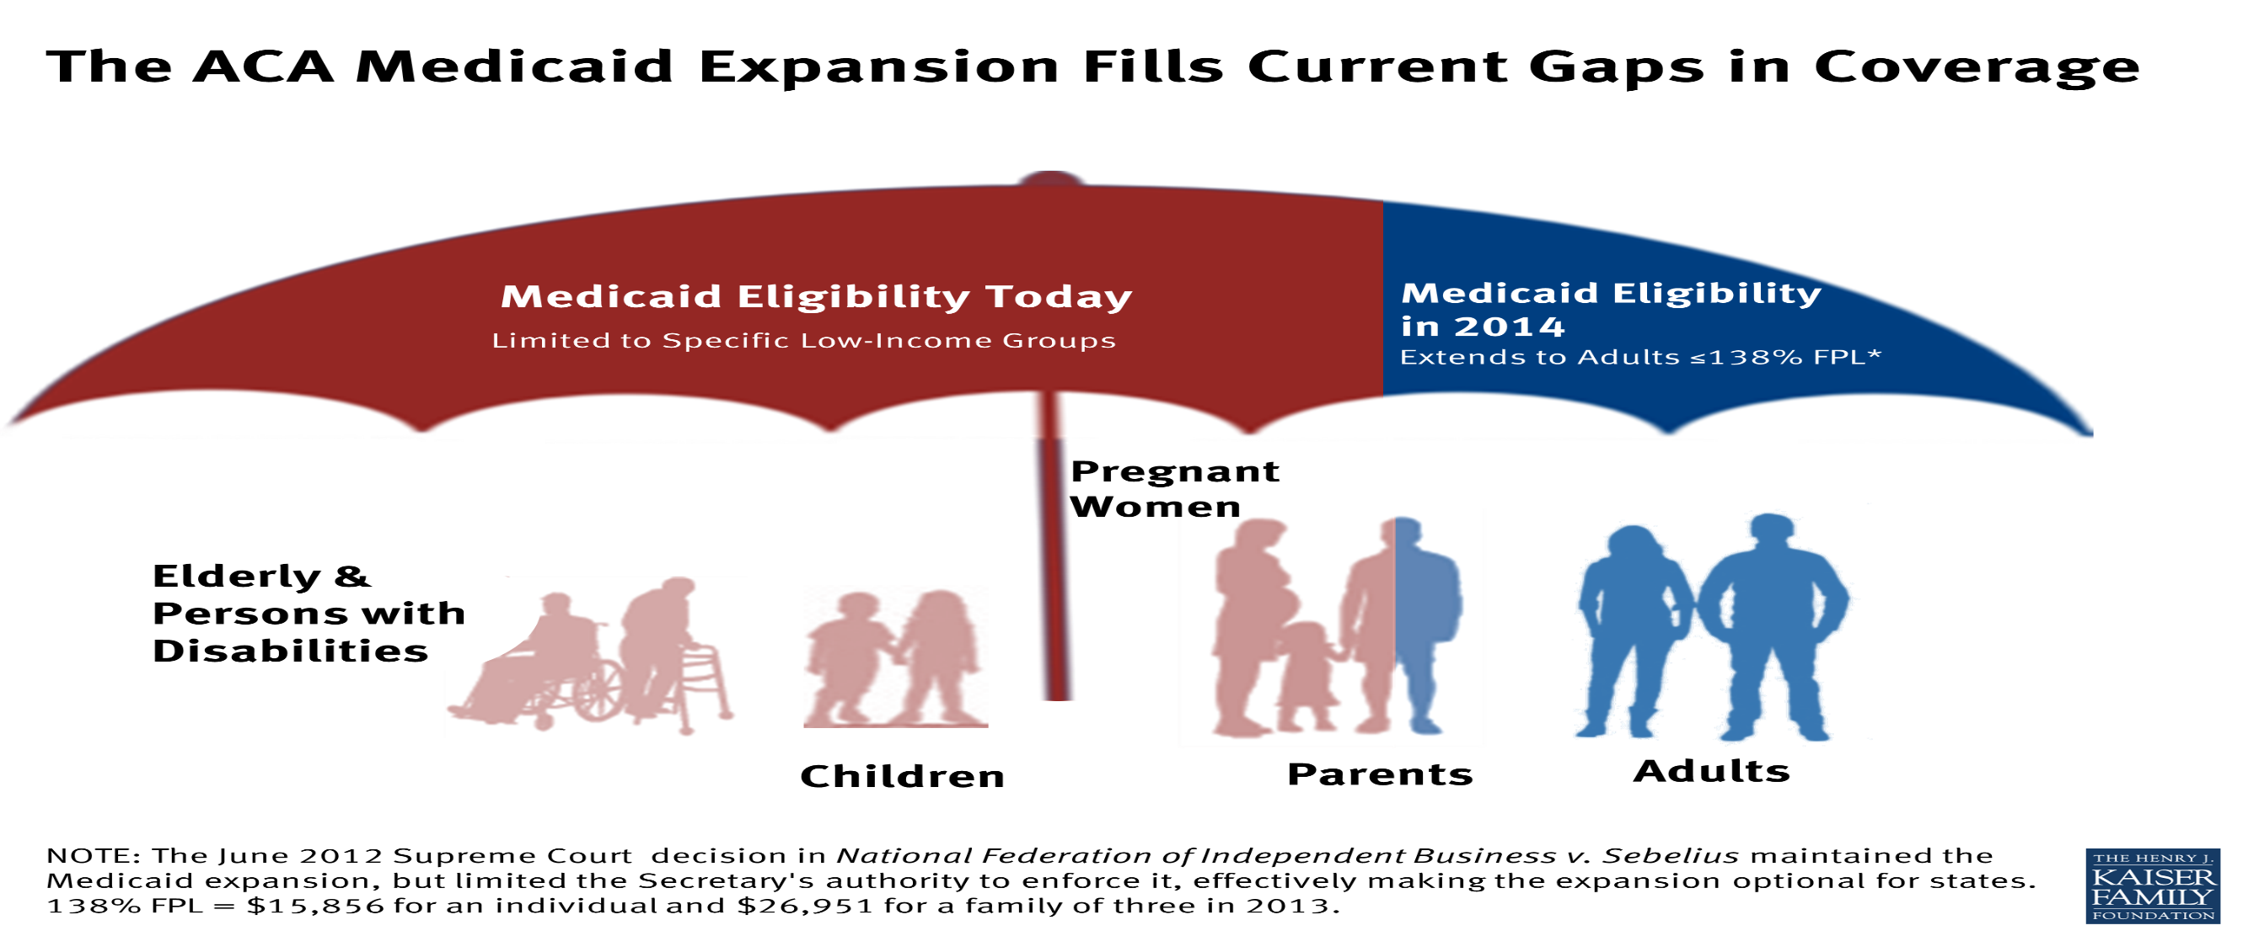
What is Medicaid Expansion?

Slide 7
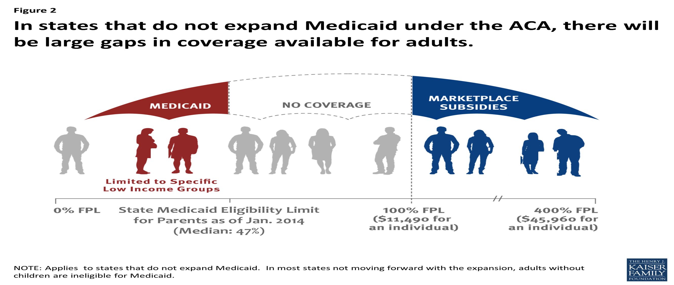
What is the coverage cap?
Notes:
The marketplace also screens eligible applicants for Medicaid
Provides options for Medicaid application upon eligibility
Medicaid applications are sent out separately for processing under concerned authority and eligibility determinations are communicated accordingly

Slide 8

HOW WILL PEOPLE IN THE COVERAGE GAP ACCESS HEALTHCARE?
Unfortunately, these individuals will NOT qualify for Medicaid and will NOT be eligible for exchange subsidies so insurance will be unaffordable and they will not purchase it.
However, they will not have to pay a penalty under the “individual mandate” but they also will not have a reliable source of health care.
They will continue to access the healthcare system through:
  Community Health Centers
  Free Clinics
  Emergency Rooms

Slide 9
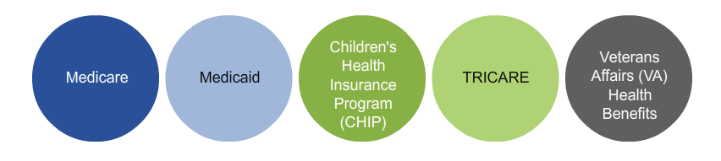
Health Insurance 101
Different Types of Health Insurance Plans

Slide 10
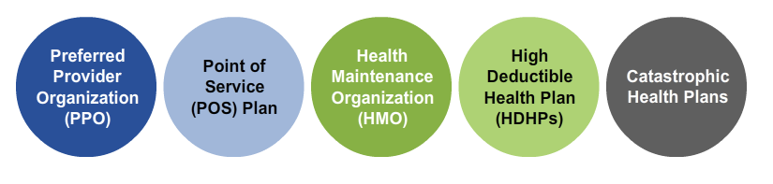
Health Insurance 101
Different Types of Health Insurance Plans

Slide 11
Health Insurance 101
Different Types of Health Insurance Plans
Preferred provider organization (PPO) - Consumers pay less if they use providers that belong to the plans network. Consumers can visit doctors, hospitals, and providers outside of the network at an additional cost. Referrals are often not needed to see specialists. In exchange for greater access to providers, premiums are generally higher in a PPO than in an HMO.

Slide 12
Health Insurance 101
Different Types of Health Insurance Plans
Point of service (POS) plan –With this type of plan, a consumer may go to out-of-network providers at a higher cost. POS plans may also require consumers to get a referral from the primary care doctor in order to see a specialist.

Slide 13
Health Insurance 101
Different Types of Health Insurance Plans
Health maintenance organization (HMO) - Usually limits coverage to care from in-network doctors who work for or contract with the HMO. It generally will not cover out-of-network care except in an emergency. In exchange for the limited access to providers, premiums are typically lower in an HMO than in other types of plans.

Slide 14
Health Insurance 101
Different Types of Health Insurance Plans
High deductible health plan (HDHPs) - a plan that features higher deductibles than traditional insurance plans in exchange for lower monthly premiums. HDHPs can be combined with a health savings account (HSA) or a flexible spending account (FSA).

Slide 15
Health Insurance 101
Different Types of Health Insurance Plans
Catastrophic health plan – a type of plan that is designed to provide emergency service and to protect consumers from unexpected medical costs, but has limits on regular doctor visits. The premium amount that a consumer pays each month for health care is generally lower than other types of plans, but the out-of-pocket cost for deductibles, copayments, and coinsurance are generally higher.

Slide 16
Health Insurance 101
Basic Insurance Terms
Premiums
  Your monthly cost for insurance coverage
Copayment
  Set cost per visit that you pay out-of-pocket at the time of service
Deductible
  Total amount you pay out-of-pocket before insurance will pay for services
Coinsurance
  % of costs you pay out-of-pocket for services

Slide 17



What different ways can I purchase health insurance?
Private Coverage Through Marketplace
Employer-based Insurance
Private Coverage Outside Marketplace
Medicaid and Medicare

Slide 18

What is the Health Insurance Marketplace?

Slide 19

How do I shop for plans in the Marketplace?
60%
70%
80%
90%
Lower Premiums
Higher Premiums
Higher cost-sharing
Lower cost-sharing

Slide 20
How can I save in the Marketplace?
When consumers get health coverage through the Marketplace, depending on income and family size, they may be able to save money. Types of cost savings include:
Advanced Premium Tax Credits
Cost-Sharing Reductions
Medicaid
PeachCare for Kids

Slide 21
What are Advanced Premium Tax Credits?
Some consumers may be able to lower the cost of their monthly premiums through advanced premium tax credits.
To qualify, consumers must apply and enroll in coverage thorough the Marketplace.
If they meet income requirements, consumers will immediately see the amount of savings for which their eligible reflected in the premium cost shown for available QHPs.
Consumers must reconcile tax credit payments on their federal income tax returns.

Slide 22
Who’s Eligible for Lower Premiums?
The amount the consumers’ eligible to save through premium tax credit depends on the consumer’s income and family size. The lower consumer’s income, the higher his or her savings will be.
Premium tax credits are available to consumers who make up to 400% FPL, which is:
  up to $46,680 for individuals
  up to $62,920 for a family of two
  up to $94,400 for a family four

Slide 23
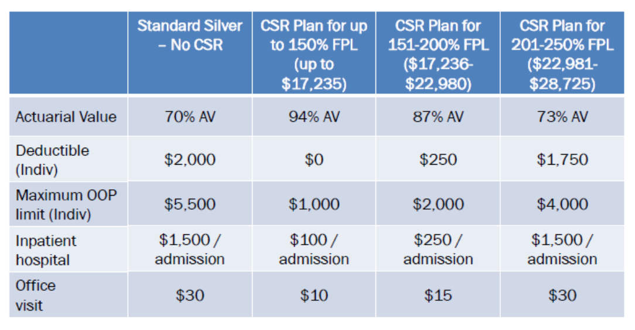
What are Cost-Sharing Reductions?

Slide 24
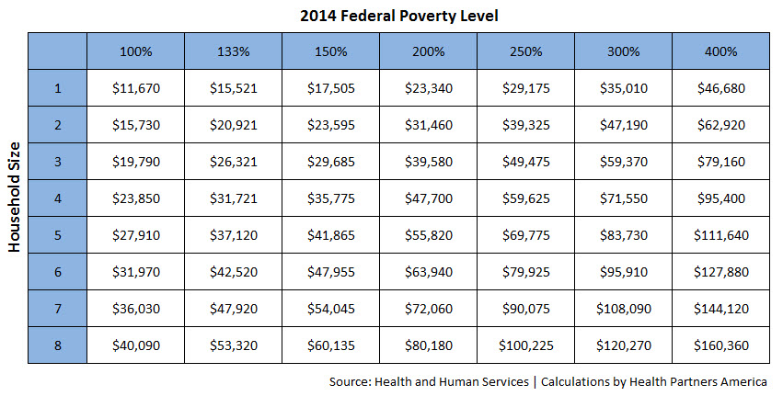
What are Federal Poverty Levels?

Slide 25



WHO IS ELIGIBLE TO PURCHASE IN THE MARKETPLACE?
Individuals and families who DON’T already have access to an affordable health insurance plan through their workplace (or other coverage such as Medicare)
Individuals who ARE offered insurance BUT the employee-only premium exceeds 9.5% of employees income or the plan does not meet a 60% minimum actuarial value
  Individuals with pre-existing conditions (who meet the above criteria)

Slide 26
When can I enroll?
Timeline
Nov 15, 2014 Dec 15, 2014 Dec 31, 2014 Jan 1, 2015 feb 15, 2015
First day to sign up for health insurance
Last day to sign up for Jan 1st coverage
2014 Health Insurance coverage and lower costs End
2015 Health insurance coverage begins
Last day to sign up for Health insurance

Slide 27

What Special Enrollment Periods?

Slide 28









What companies are offering insurance in the Marketplace?

Slide 29
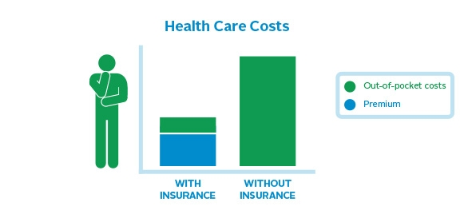
Why should I consider purchasing health insurance?

Slide 30
What if I’m already enrolled in the Marketplace?
Review
Plans change, people change – review your coverage and look for a letter from your plan about how your benefits and costs may change next year
Update
Starting November 15, log in and update your 2015 application - make sure your household income and other information is up-to-date for next year
Compare
Compare your current plan with other plans that are available in your area
Choose
Select the health plan that best fits your budget and health needs
Enroll
The marketplace opens on November 15, make sure to make changes by December 15 to have any changes take effect on January 1.

Slide 31
What does ACA require me to do?
Individual Mandate:
The individual responsibility requirement, also known as the individual mandate, is a provision of the Affordable Care Act requiring that all citizens obtain a minimum standard of health insurance coverage starting in 2014 OR obtain an exemption OR pay a fine when filing their federal income tax return.
Notes:
A key feature of the Affordable Care Act is the so-called “Pay or Play” rules. What this means is that those who fail to “play”; i.e., buy coverage for themselves or their employees (if required) will “pay”; i.e. owe a penalty that is payable to the federal government via their income tax return. The individual mandate requires Americans to have health insurance. Those who don’t will pay a penalty. The employer mandate requires large employers (i.e., those with 50 or more full-time employees or full-time equivalents) to offer their employees health insurance that is adequate, affordable and covers a list of essential health benefits (see Slide #6). It does NOT require employers to offer coverage to an employee’s spouse in order to comply with the employer mandate.
Notes:
Exceptions: Uninsured people won't have to pay a fee (tax) if they:
are uninsured for less than 3 months of the year
are determined to have a very low income and coverage is considered unaffordable
are not required to file a tax return because their income is too low
would qualify under new income limits for Medicaid, but their state has chosen not to expand Medicaid eligibility
are a member of a federally recognized Indian tribe
participate in a health care sharing ministry
are a member of a recognized religious sect with religious objections to health insurance
If you don't qualify for these situations, you can apply for an exemption asking not to pay a fee. You do this in the Marketplace. https://www.healthcare.gov/what-if-someone-doesnt-have-health-coverage-in-2014/
A full-time employee is defined as someone who works, on average, 30 hours per week or 130 hours per month.
There are many issues that an individual, family, and/or farm operator will have to consider to make best use of what the ACA has to offer. Some may choose to purchase a health insurance plan. Some may choose to pay a penalty. There are advantages and disadvantages to either course of action.

Slide 32
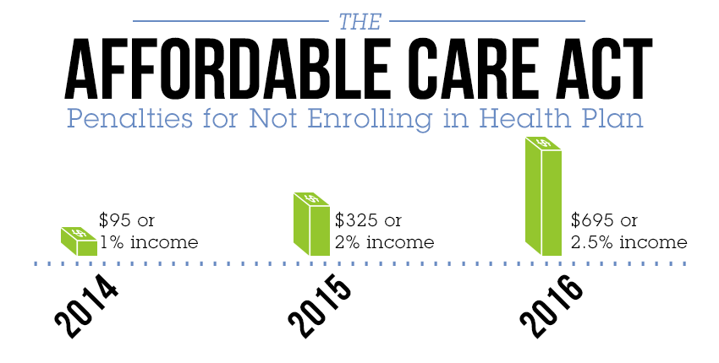
How much is the fine?
up to $285/family
up to $975/family
up to $2,085/family

Slide 33
Who is Exempt from the fine?
People Who:
  are uninsured for less than 3 months of the year
  can’t find affordable health insurance
  enroll in the marketplace by the close of open enrollment (February 15, 2015)
  are determined to have very low income and coverage is considered unaffordable (coverage would be more than 8% of income)
  are not required to file a tax return because their income is too low
  would qualify under the new income limits for Medicaid, but their state has chosen not to expand Medicaid eligibility
  are undocumented citizens
  are a member of a federally recognized Indian tribe
  participate in a health care sharing ministry

Slide 34

How do I get coverage through the Marketplace?

Slide 35



QUESTIONS?
Contact me:
Nykita Howell
nhowell@healthyfuturega.org
404-567-5016

